Slide 1

Emollient Use &
Personal Fire Safety
© 2022 Z Cares Social Care Consulting Ltd.
For use by the purchasing service only.

Slide 2
This Presentation
Part One – for all staff
Emollient creams – quick refresher
Why they are a hazard
Your responsibilities and rights
Record keeping
Reporting
Inspection guidance
Part Two – for assessors, auditors and managers
What to assess, and how
Good assessments and care plans
Auditing of documents and records
Potential conflicts
Inspection guidance
Handouts - Case Studies and Questions

Slide 3
Part One

Slide 4
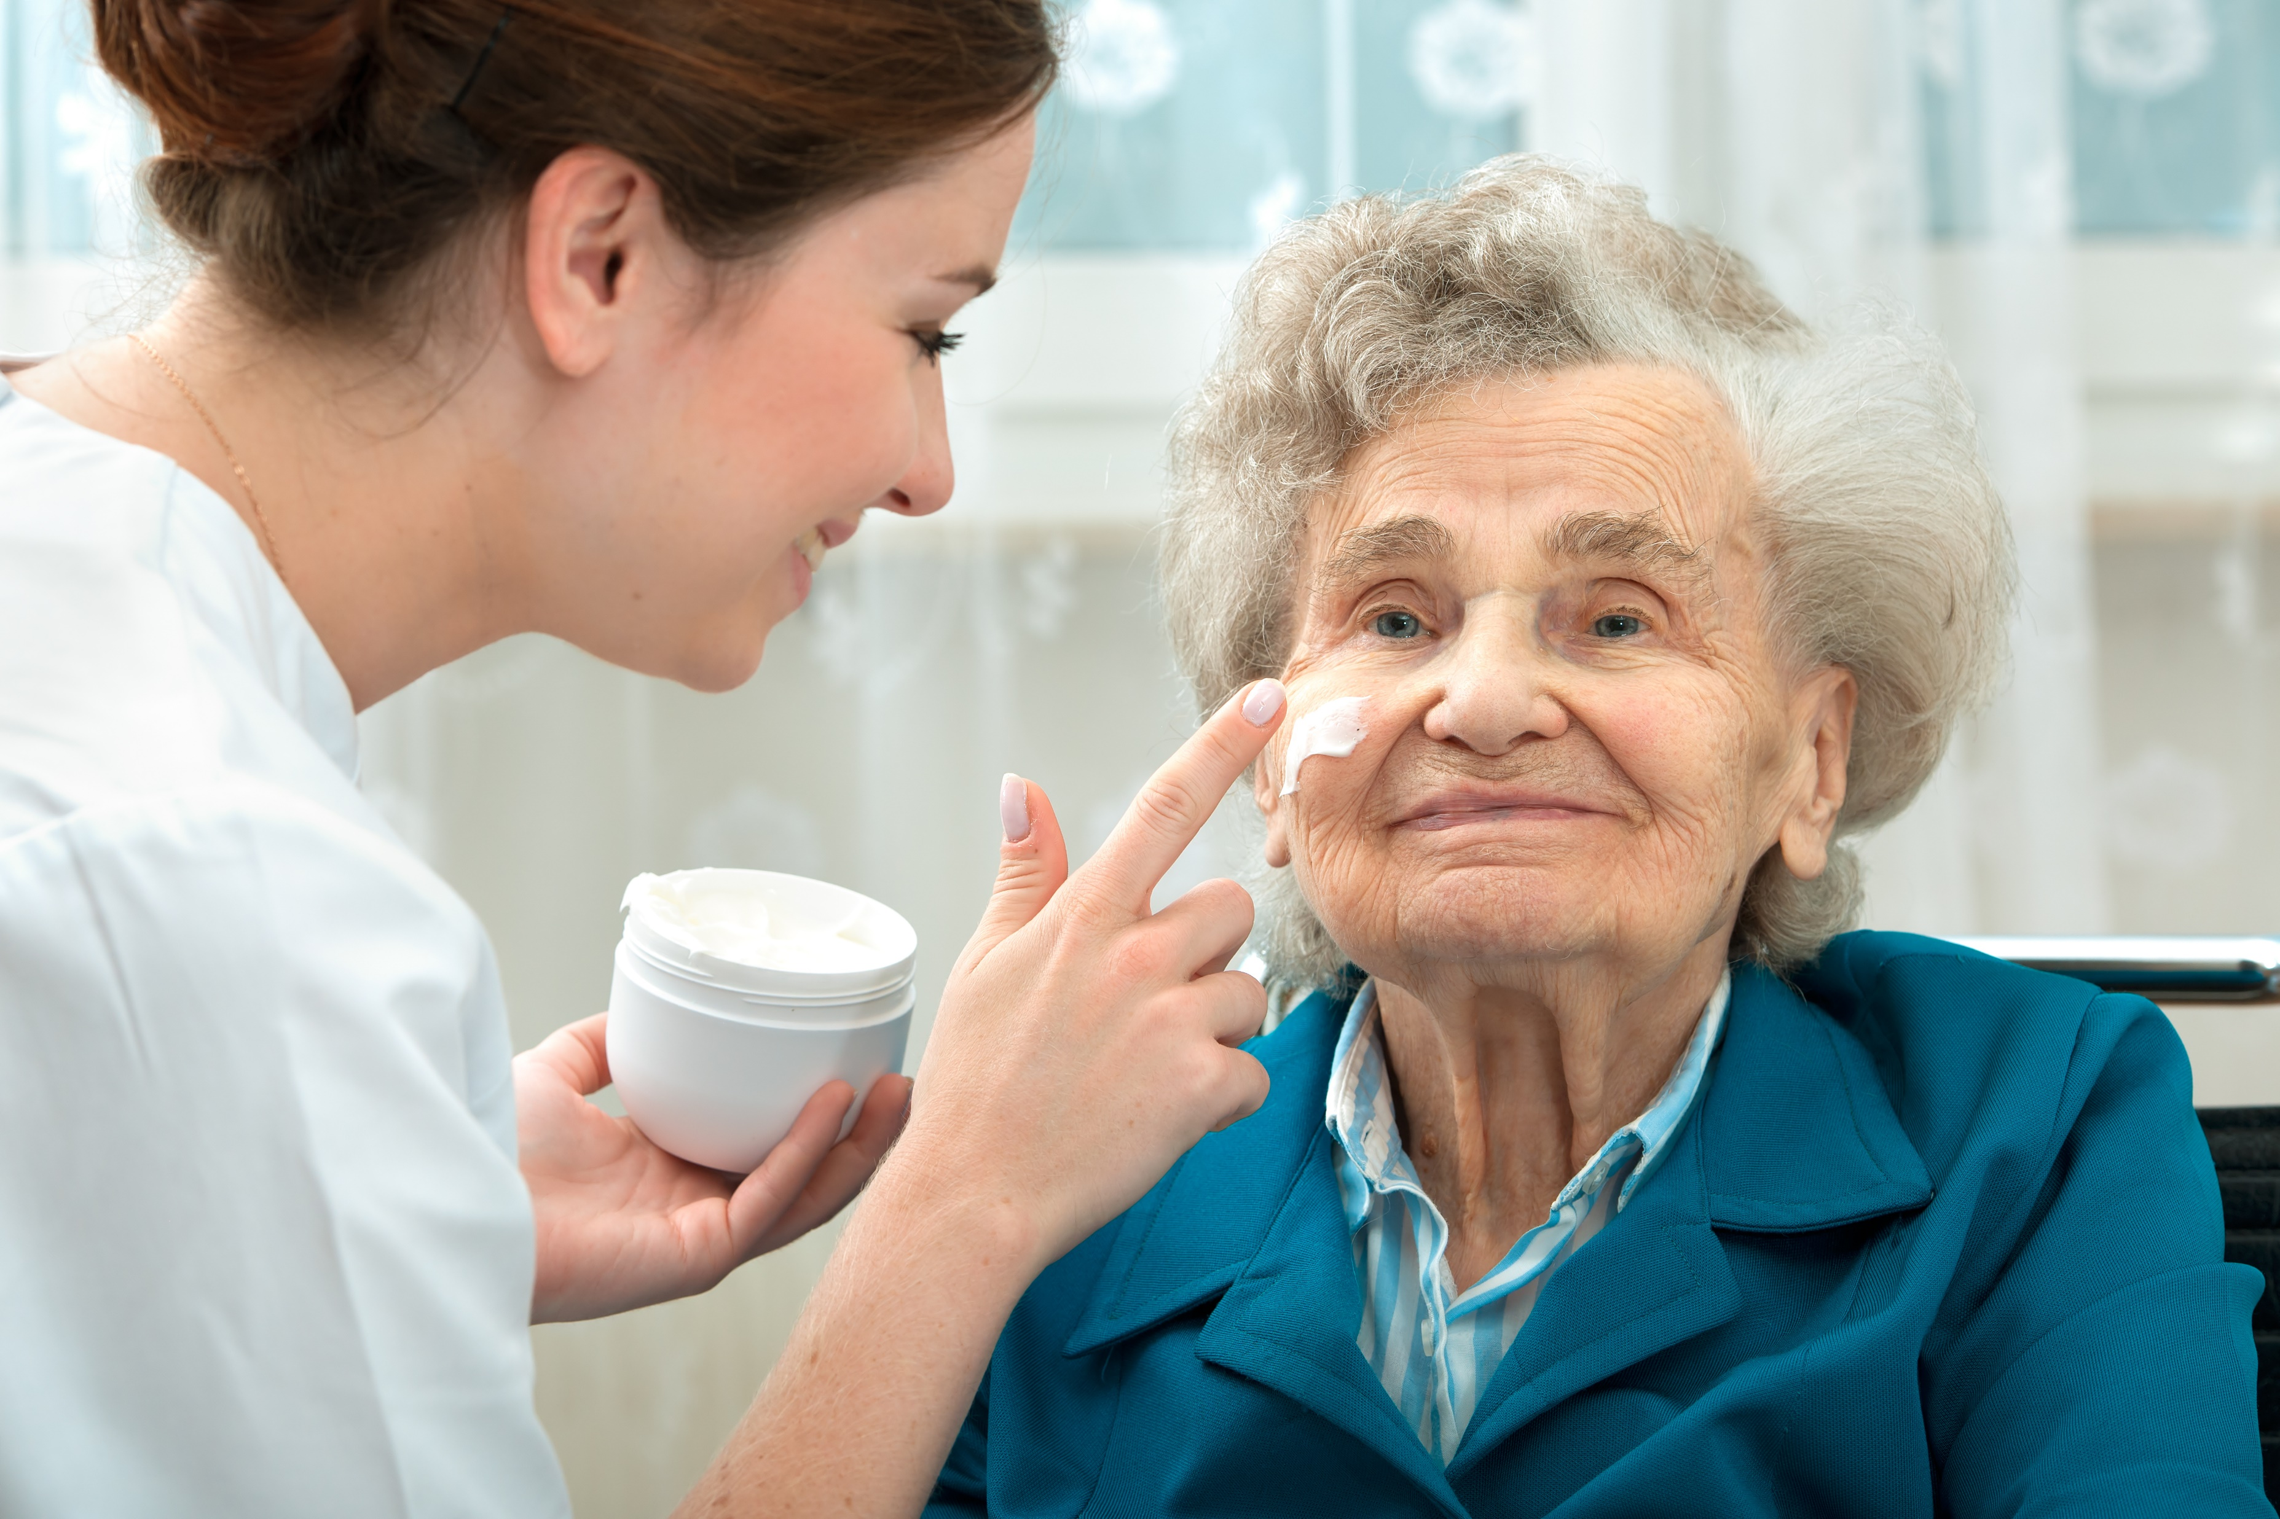
Emollients – A Quick Refresher
“Emollient” is the medical word for moisturiser and is derived from the Latin verb mollire, “to soften”.
They soothe the skin and relieve itching and dryness. Emollients come in different types and have many uses.

Slide 5
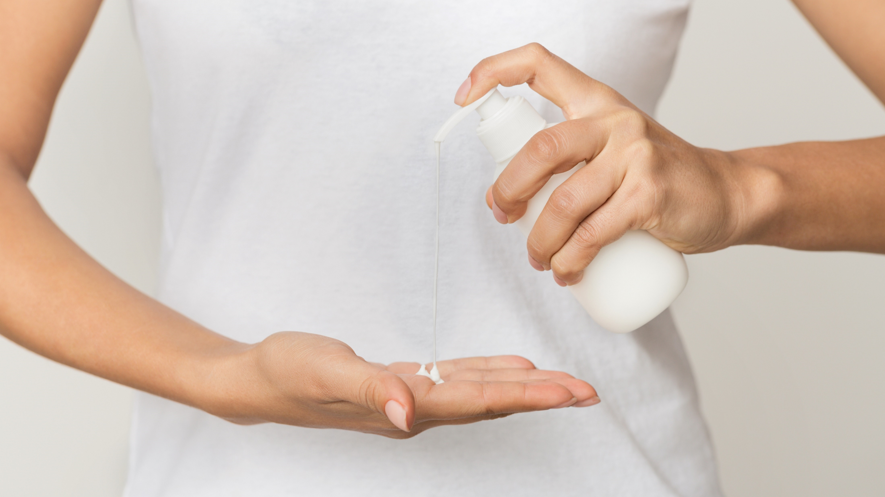
Emollients as soap substitutes
People with skin conditions often avoid soap, which is very drying. Any emollient (except white soft paraffin alone) can be used with water to cleanse the skin.
Products containing sodium laureth sulphate should be avoided by people with eczema, as it can irritate their skin.

Slide 6
Emollients left on the skin
Emollient products range from very greasy ointments for very dry skin to the lightest of lotions.
Lotions contain the most water and least fat than heavier products, and so need to contain the most preservatives. They spread easily and absorb quickly, but aren’t a great moisturiser for very dry skin.

Slide 7
Creams are a mixture of fat and water and although easy to spread are not greasy, so tend to be preferred for routine daytime use.
They need some preservatives, but are effective moisturisers when applied liberally and frequently.
Gels are usually light and non-greasy despite having a relatively high oil content.
Emollient sprays are especially useful for applying on places which are hard to reach, and when an area can’t be touched.
Ointments can be greasy and not feel acceptable on the skin for day to day use, but are excellent for very dry areas, when used under wraps, or at night.
They should not be used on weeping skin.
Emollients containing humectants usually need to be applied less often as they draw moisture deeper into the skin.

Slide 8
Applying emollients
Spot the obvious bad practice in this stock photo!

Slide 9
Applying emollients
Spot the obvious bad practice in this stock photo!
The care worker is applying cream straight from the pot with her bare hands.

Slide 10
Where possible, products should be supplied in packaging with a pump dispenser so you can avoid touching it altogether.
If this isn’t possible, and you need to use quite a lot of product, to prevent the contamination risk from “double dipping” you should take the required amount from the pot with a clean teaspoon or spatula, and put it in a suitable vessel like a clean ramekin or medicine pot.
If there’s no specific measurement given, follow the instructions carefully and don’t over-apply the product - this can also cause other problems such as excess barrier cream reducing the absorbency of incontinence pads and sheets.

Slide 11
Emollients should be applied by smoothing them into the skin along the line of hair growth, rather than rubbing them in.
If you are also applying a prescribed topical medicine (such as a corticosteroid) after you have applied an emollient, you must leave a gap of at least 15-30 mins after the emollient before applying the medicine.
Emollient products shouldn’t be shared with other people for obvious infection control reasons.
Gloves used during emollient application must be clean and freshly changed just before application.

Slide 12
Question for discussion
Which types of products do you think might be dangerous, and why?

Slide 13
Question for discussion
They are all potentially dangerous in a personal fire!

Slide 14
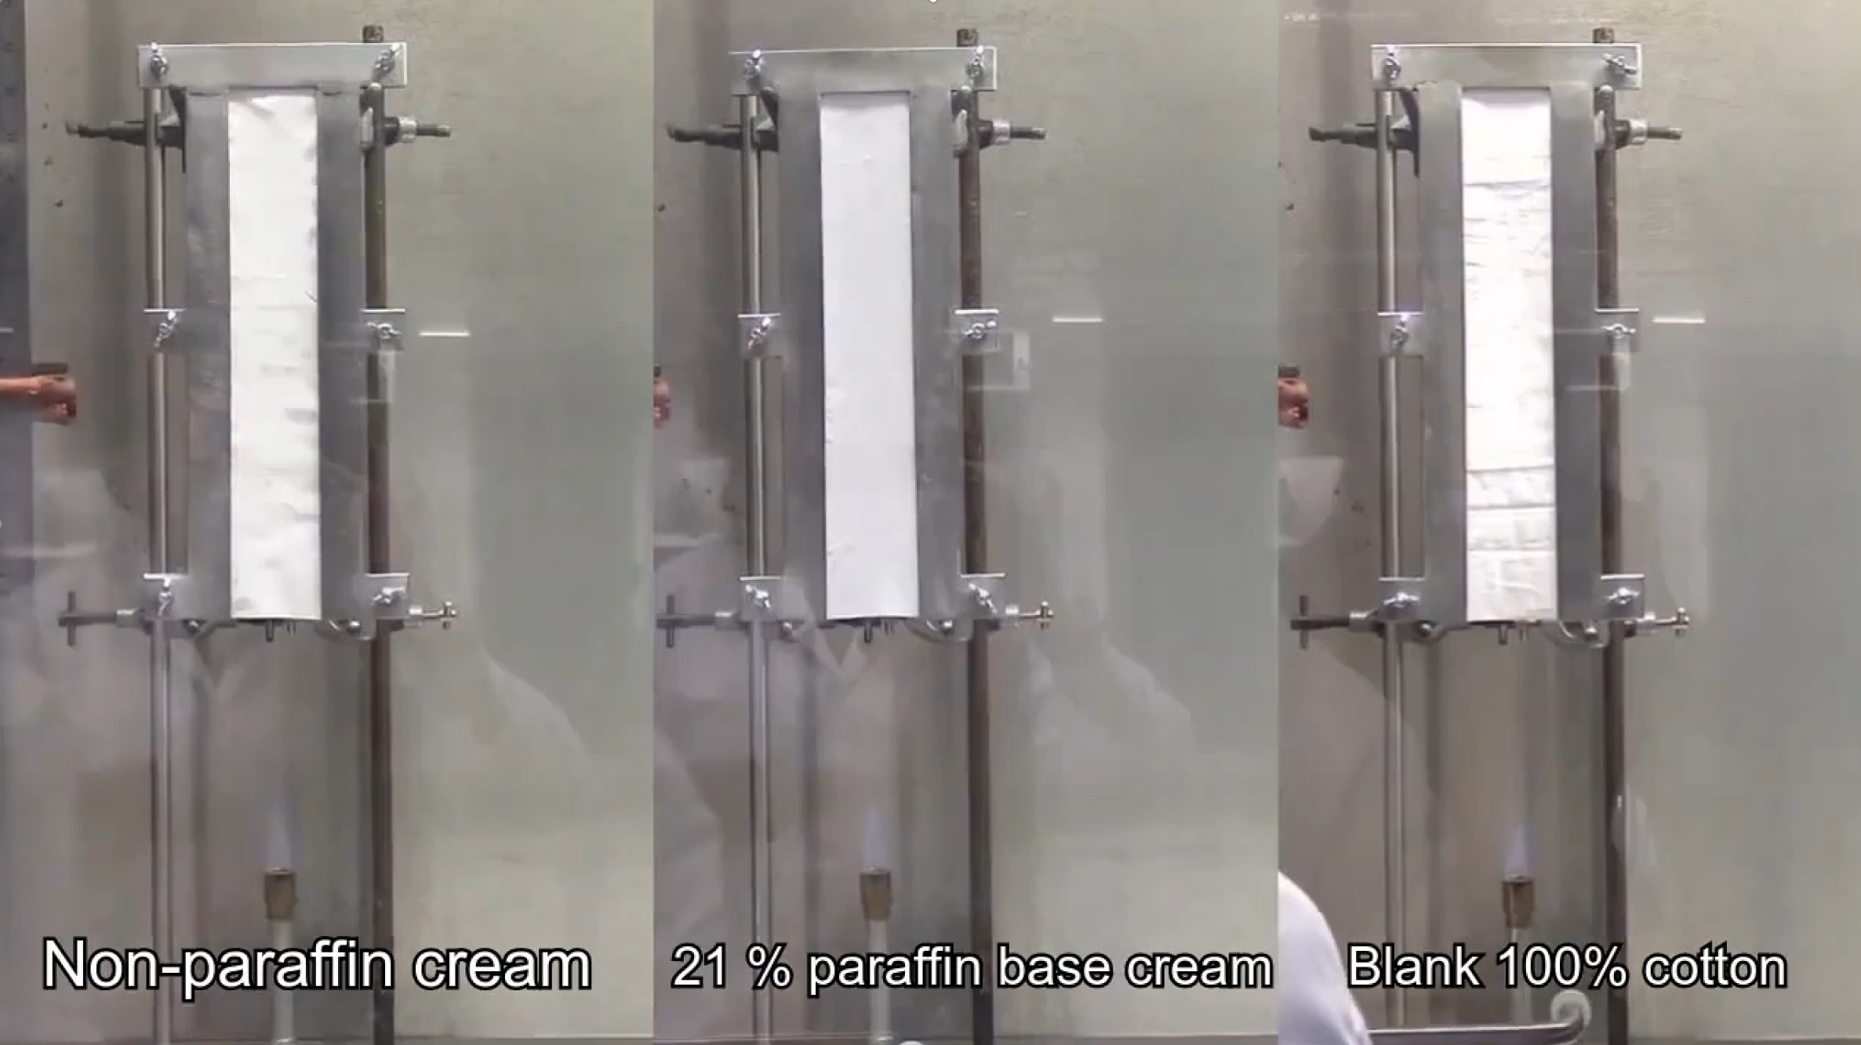
The following video was made by researchers at Anglia Ruskin University.
Which of the fabric samples tested in the video do you think will catch fire first?
a
b
c

Slide 15
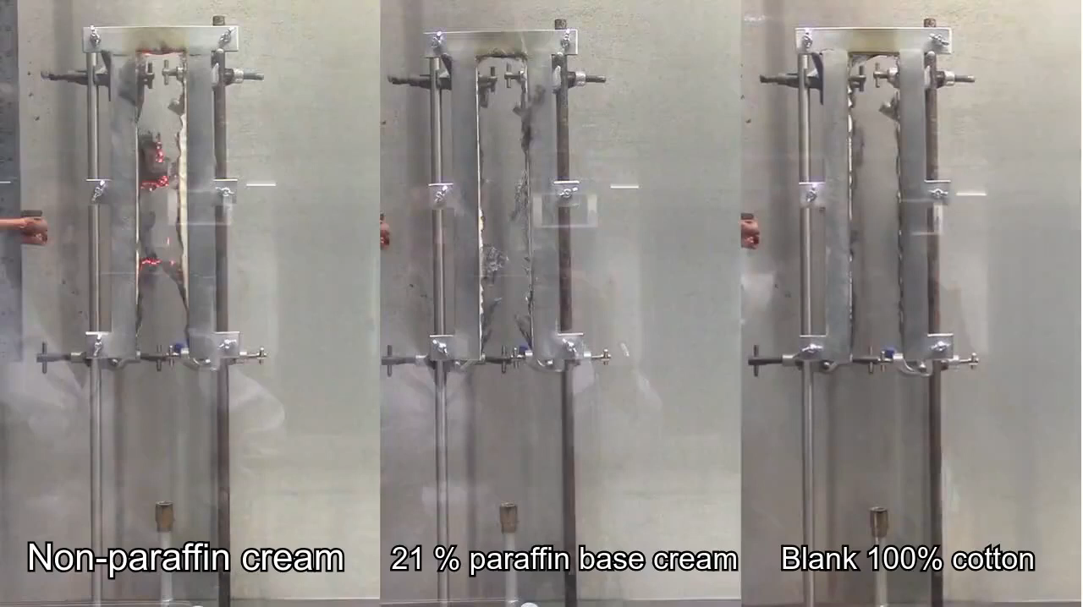

Slide 16
Are emollients flammable?
Emollients can transfer from the skin onto clothing, bedding, dressings, and other fabric. Once there, they can dry onto the fabric and build up over time. In the presence of a naked flame, fabric with emollient dried on is easily ignited.
The products are not especially flammable themselves but they act as an accelerant, meaning they increase the speed of ignition and intensity of the fire, when fabric with residue dried on it is ignited.

Slide 17
Potential Sources of Ignition
Care homes are exempt from the rules about indoor smoking, as someone’s room is considered their home.
However, like most private landlords, services often ban smoking as a condition of renting the room out in the first place. Communal areas are affected by the smoking ban.
Cigarettes, pipes, matches, lighters
Candles, scented oil burners, incense
Reflected sunlight off mirrors, crystal ornaments, glass door handles, etc.
Fireplaces and heaters
Can you think of any others?

Slide 18
Potential Sources of Ignition
Care homes are exempt from the rules about indoor smoking, as someone’s room is considered their home.
However, like most private landlords, services often ban smoking as a condition of renting the room out in the first place. Communal areas are affected by the smoking ban.
Cigarettes, pipes, matches, lighters
Candles, scented oil burners, incense
Reflected sunlight off mirrors, crystal ornaments, glass door handles, etc.
Fireplaces and heaters
Can you think of any others?
“These sort of incidents are not as rare as you would think. I've seen everything from sparkly doorknobs and crystal balls to glass fishbowls and Nutella jars containing crystals starting fires.”
(Charlie Pugsley, head of the London Fire Brigade's fire investigation team, in 2018.)

Slide 19
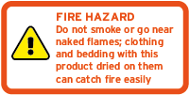
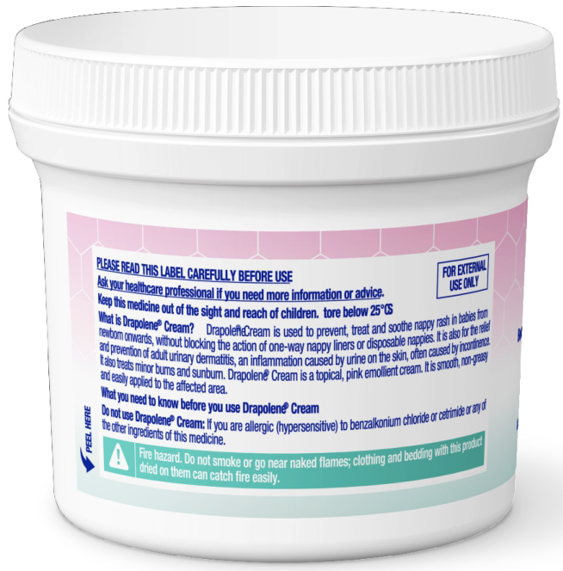
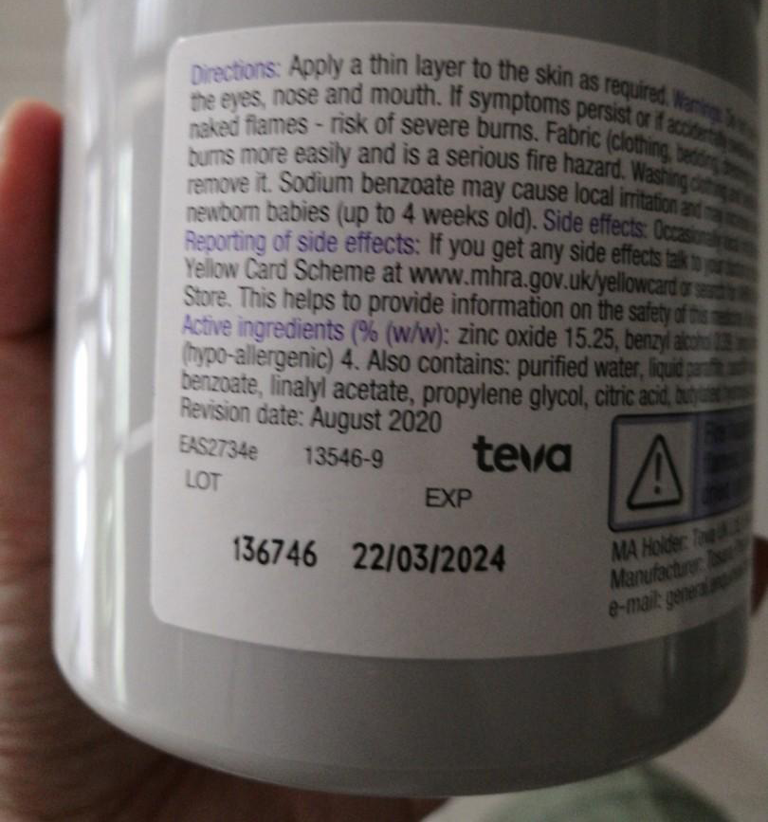
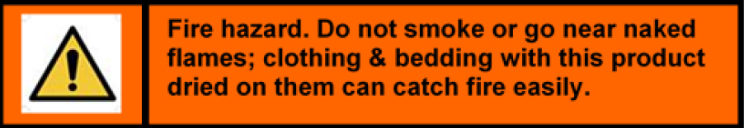




Warning Label Examples
Sudocrem
Drapolene

Slide 20
Question for discussion
Why might personal fires be especially dangerous or more likely for people receiving care and support?

Slide 21
Reasons include:
If someone has limited movement, they may not be able to get away from the source of ignition.
They may not have the dexterity be able to deal with a small clothing fire, such as from a lit cigarette.
They may be unable to summon help before they are injured or overcome by smoke.
People with sensory loss may not see or smell a nearby fire before it is too late.
People with lack of sensation may not feel the heat of a fire, even if their skin is directly involved, until it spreads beyond the affected area.
People with cognitive impairment may not react appropriately to the emergency.

Slide 22
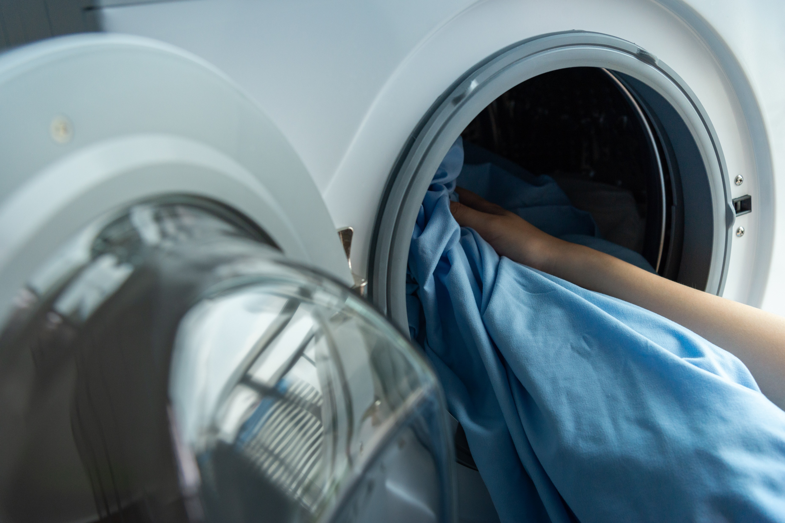
Laundry
Changing clothing and bedding frequently and washing at higher temperatures will reduce emollient build up but does not totally remove it – there will always be a residue.
Emollient affected fabric is also a potential source of laundry fires, so steps need to be taken to reduce that risk, such as avoiding tumble drying and ironing as much as possible.

Slide 23
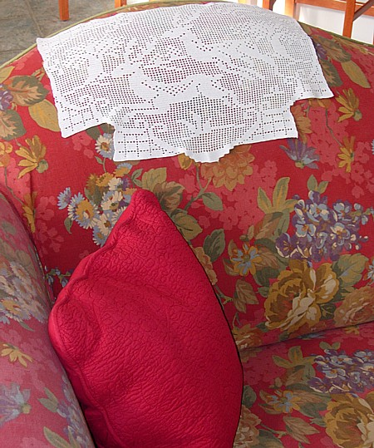




Don’t forget…
Throws, cushion covers and antimacassars will need to be laundered frequently too.
People may need to get more items like hats, dressing gowns and housecoats to ensure they are always available when needed.
People’s needs could change according to the season – e.g. sunscreen use in summer.

Slide 24

Record keeping
Only apply products that are listed in the risk assessment and support plan.
Record prescribed products on a topical MAR chart
Record other products in the care notes. You need to specify exactly what you have applied to where
“Do these notes prove I am keeping this person safe?”

Slide 25
Record keeping
Only apply products that are listed in the risk assessment and support plan.
Record prescribed products on a topical MAR chart
Record other products in the care notes. You need to specify exactly what you have applied to where
“Do these notes prove I am keeping this person safe?”
If your handwritten records are unreadable, then the answer to this question is always NO!

Slide 26

The vast majority of people are not in any danger because of their emollient use, and the benefits usually far outweigh the risks.

Slide 27
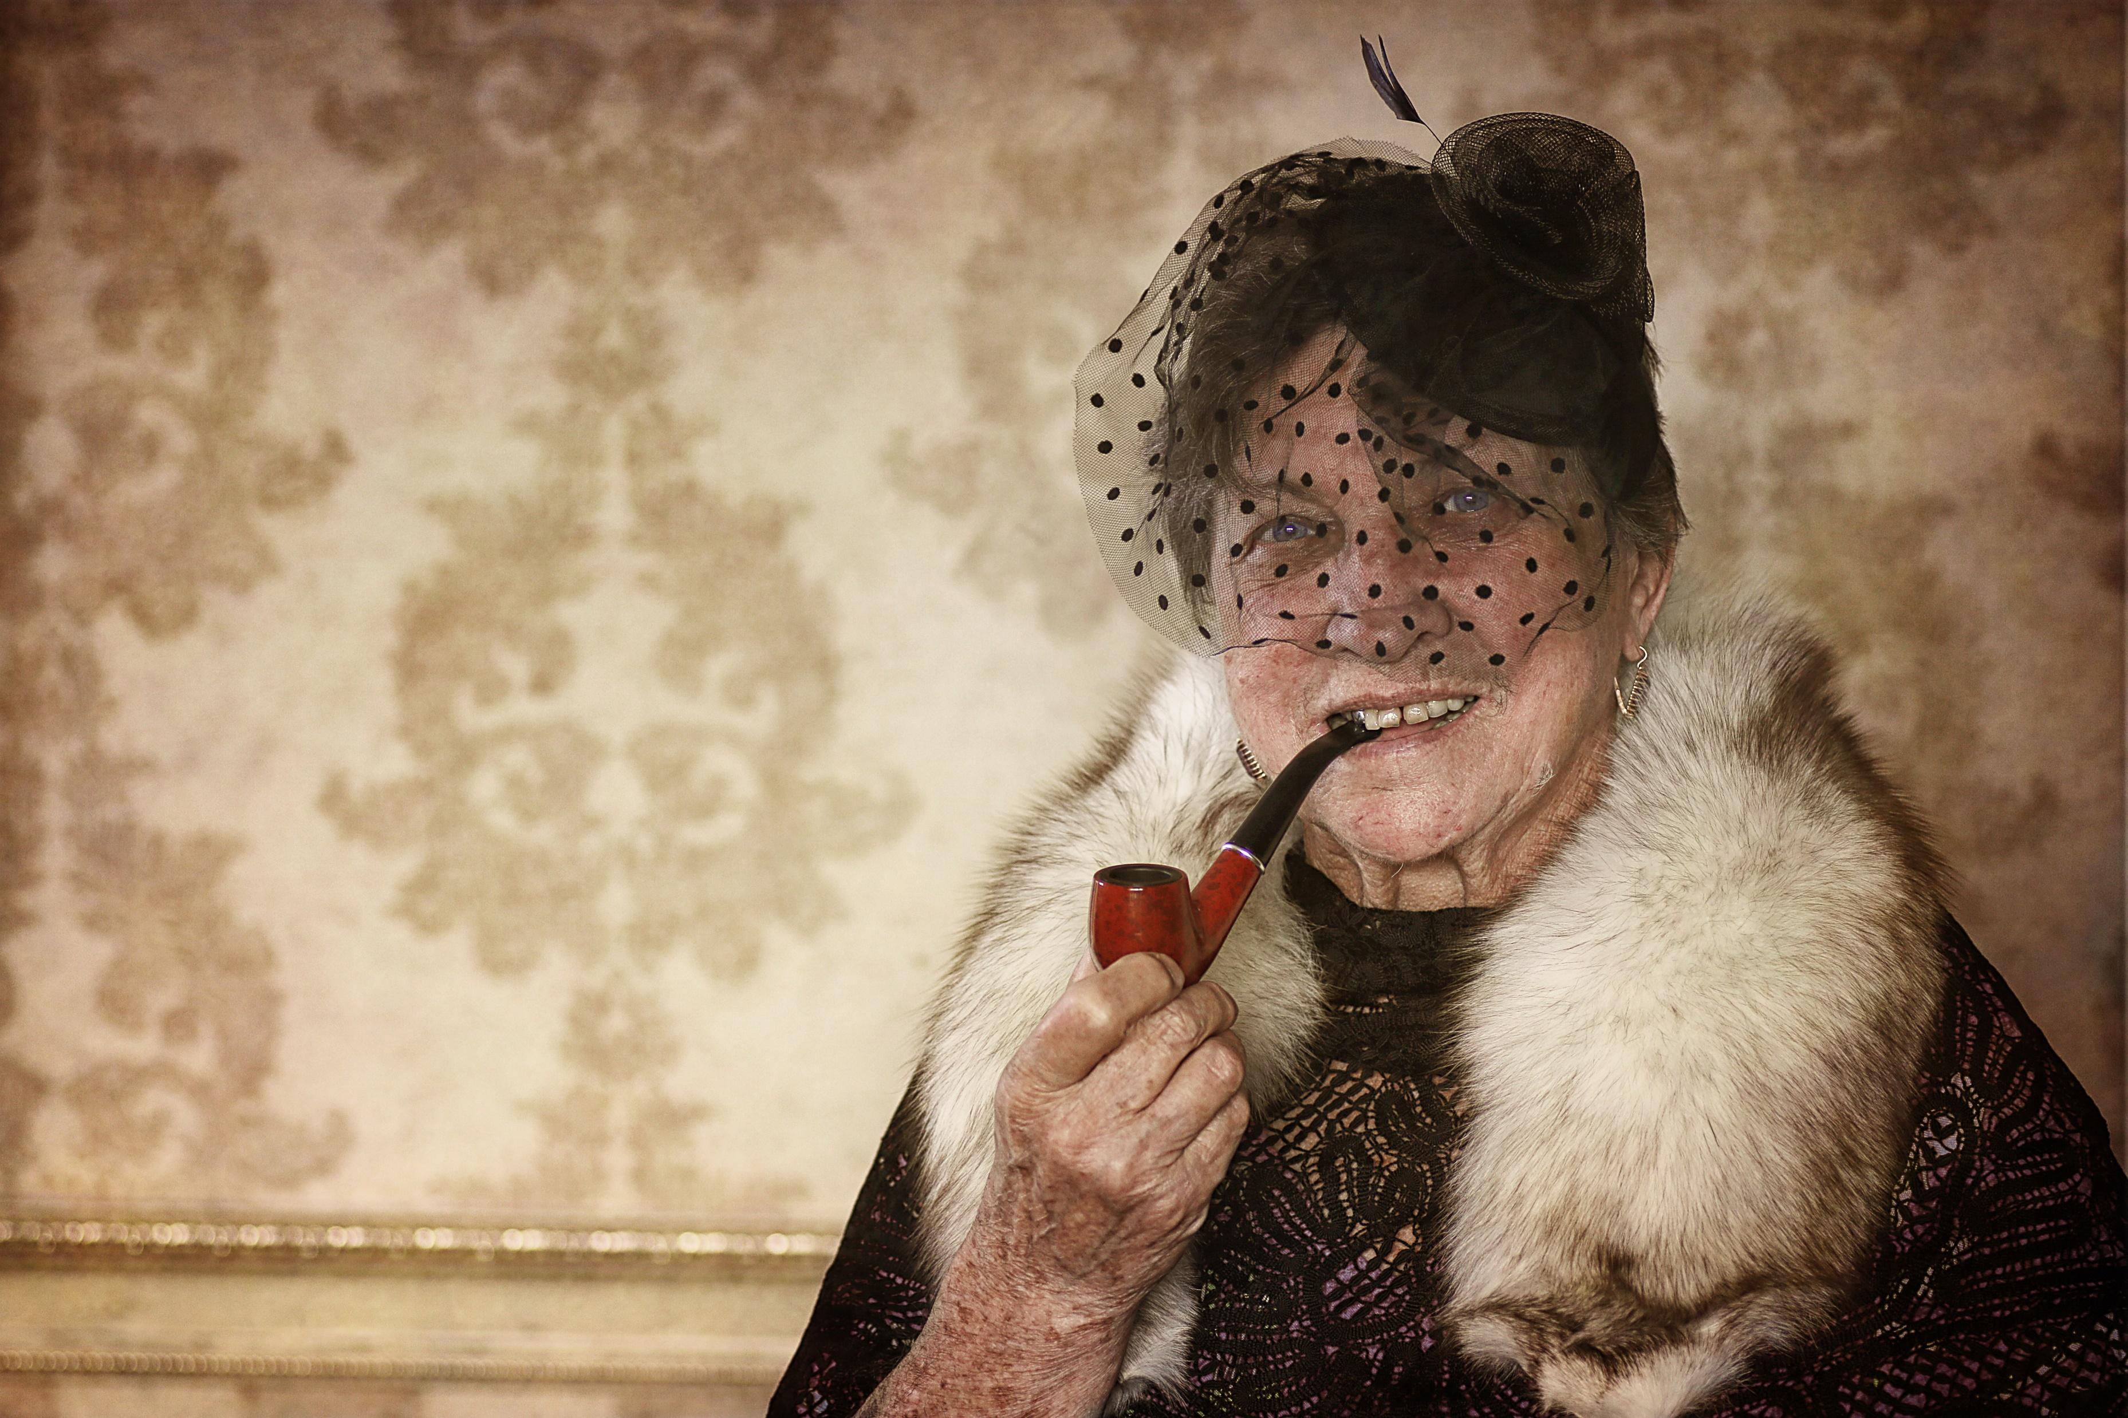
Supporting people who are at risk
You may be asked to support emollient users in taking risks by exposing themselves to potential sources of ignition.
People have the right to take such risks, even if this sometimes seems dangerous or unwise, like smoking.

Slide 28
It is important to recognise that whilst smoking is of course an addiction, it is also a source of comfort to many people and should never be spoken of as a deficiency or failing on their part.

Slide 29
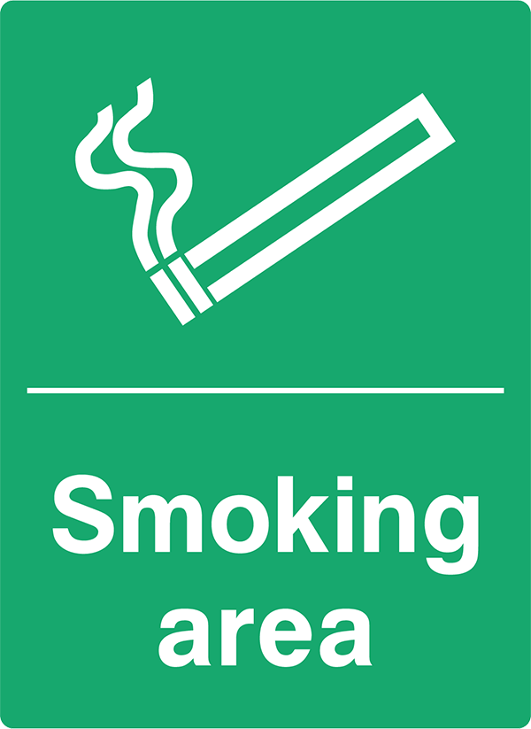
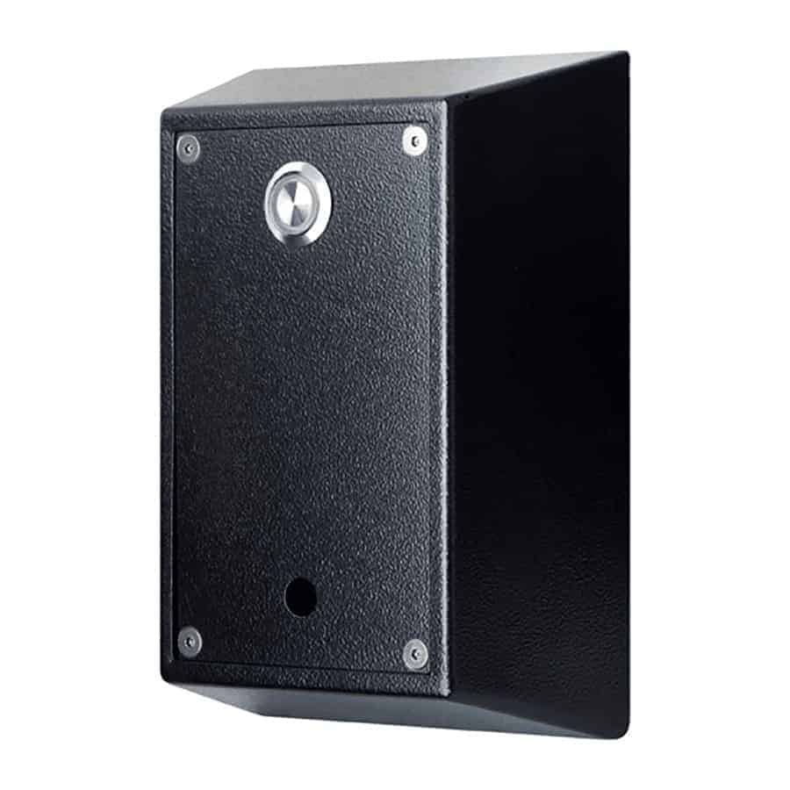
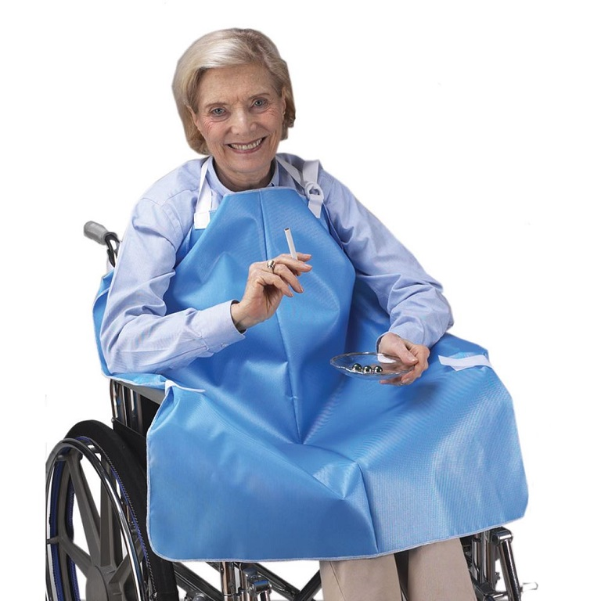
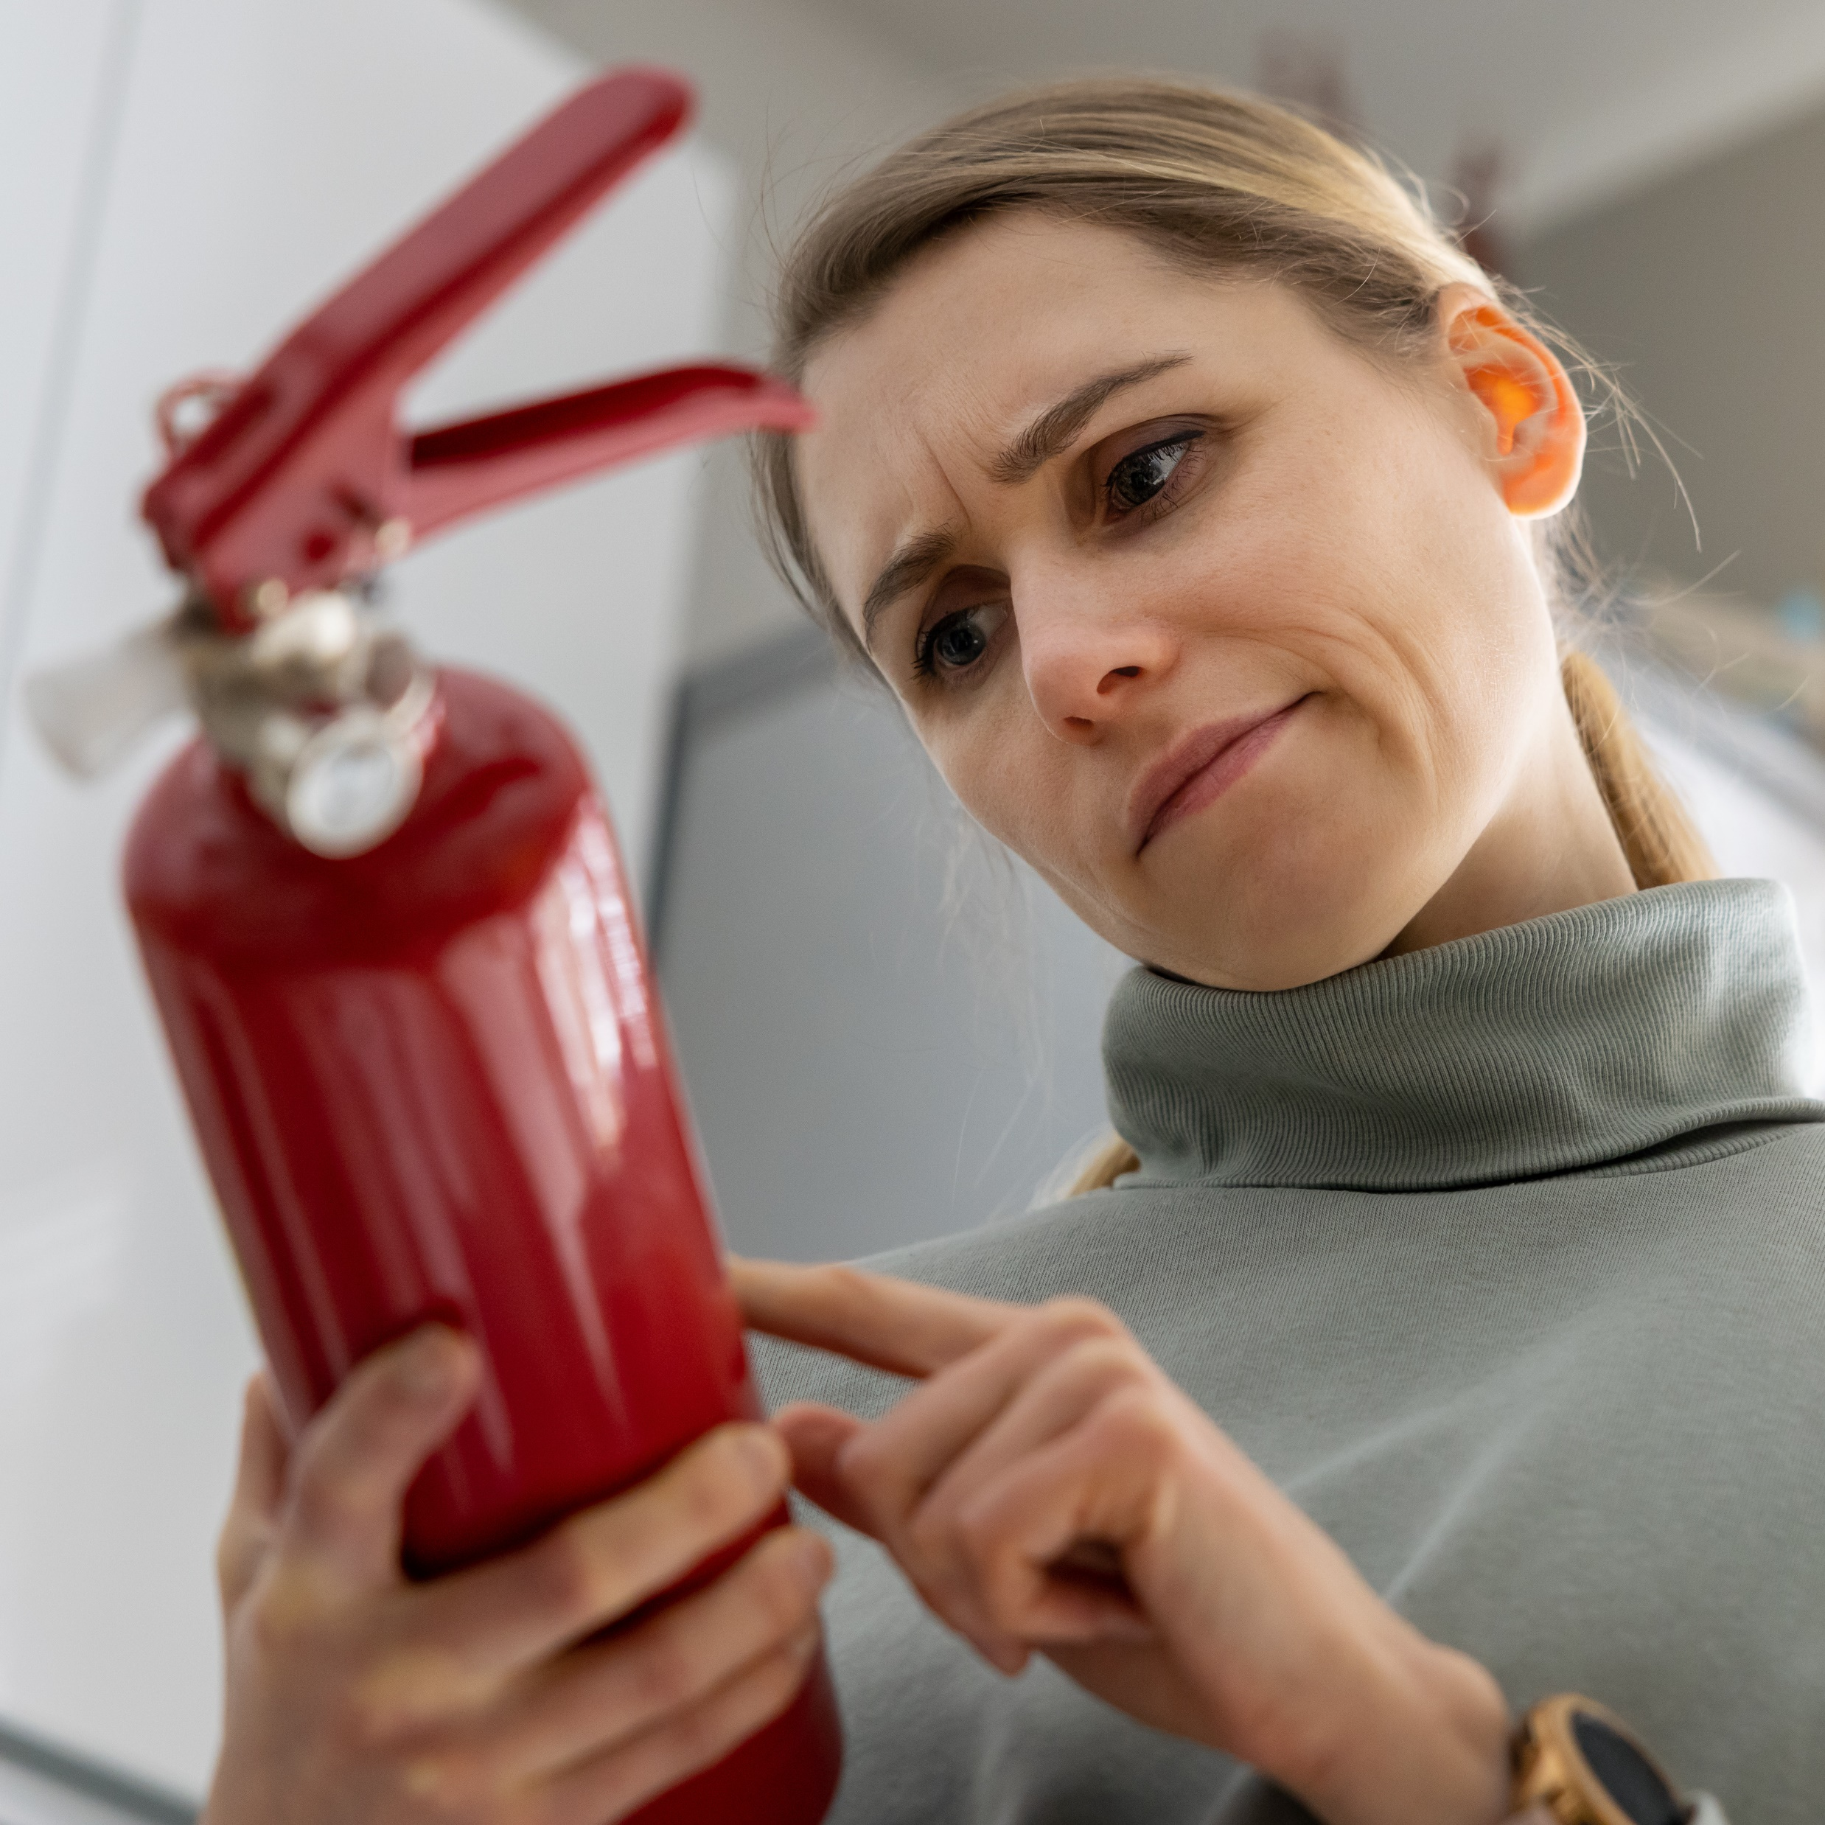
Safer smoking in care homes
Any other ideas?
Wall mounted flameless lighter
Smoker’s apron
Accessible signage
Staff knowing how to respond in an emergency and doing so quickly

Slide 30
Smoking indoors
People (or their household/visitors) should absolutely not be casually smoking when a care worker is present.
However, you may find yourself asked to support someone with safer smoking as part of a wider risk management plan.
You have the right to refuse if this puts you at risk, such as from passive smoking.
However, you can also choose to accept risks, so such a service would be a good match for members of staff who smoke.
There should always be detailed instructions and emergency plan in place. If you don’t think these are adequate, report this urgently.

Slide 31
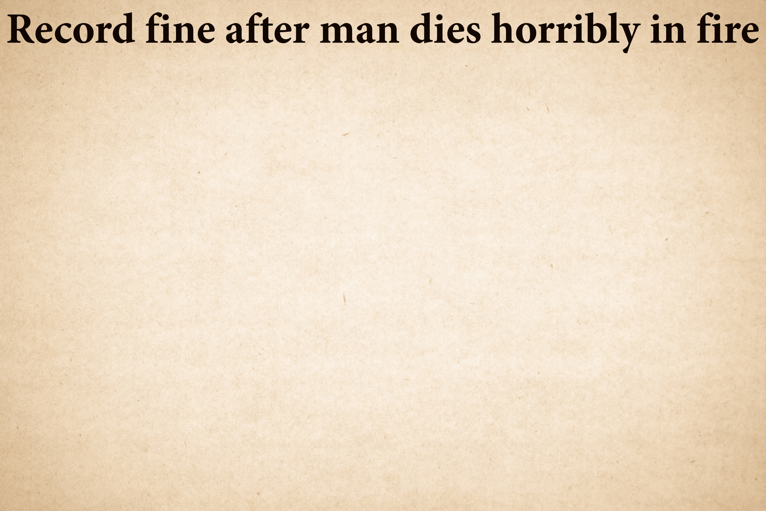
For consideration and discussion:
Does the fine seem proportionate?
Does the home’s response seem adequate?
Would more regular checks have prevented this disaster?
With the benefit of hindsight, what would you do differently?
BUPA have been ordered to pay a record amount following prosecution brought by London Fire Brigade
In January 2022, BUPA Care Services (ANS) Ltd was fined a record amount of £1.04m (£937,500 for failings and £104,000 costs) by Southwark Crown Court on 5 January 2022.
London Fire Brigade brought the prosecution against BUPA under the Regulatory Reform (Fire Safety) Order after it was called to the March 2016 blaze at the Manley Court care home, in John Williams Close, Brockley.
BUPA pleaded guilty to contravening Article 11(1), which relates to the management of fire safety measures. Specifically, it accepted that it had failed to:
• Ensure staff understood the risks from the use of emollient creams;
• Warn residents using paraffin-based products not to smoke, or, require precautions to be taken such as the use of a smock or apron;
• Instruct staff not to leave a resident using paraffin-based products smoking unsupervised; and
• Carry out an individual smoking risk assessment of the resident as normal with the control measures in place
The incident
Mr Cedric Skyers, a 69-year-old wheelchair user, died after catching fire while smoking unsupervised in a shelter in the garden of the home. A care assistant saw the fatal blaze from a first floor window and called 999 before staff attempted to put the fire out, but the pensioner sadly died of his injuries.
A subsequent investigation found that although a smoking risk assessment had been carried out for Mr Skyers, it did not assess his use of emollient creams, which can be flammable if allowed to build up on skin, clothes or bedding.
Apparent burn marks indicating previous incidents were found on Mr Skyers' clothing during investigation after his death. Care home staff said they had not been aware of these and the risks associated with emollient use. They said if they had known, they would have ensured more regular checks were made when he was smoking.

Slide 32














Absolutely no precaution is a substitute for being supervised by staff.

Slide 33
Reporting
You must report any changes to a person’s emollient use or anything that might impact their safety in this area.
If you don’t think a person is being kept safe, you should escalate your concerns appropriately.
Mini refresher:
Reporting to the office
How to escalate your concerns within the service and beyond it if necessary

Slide 34
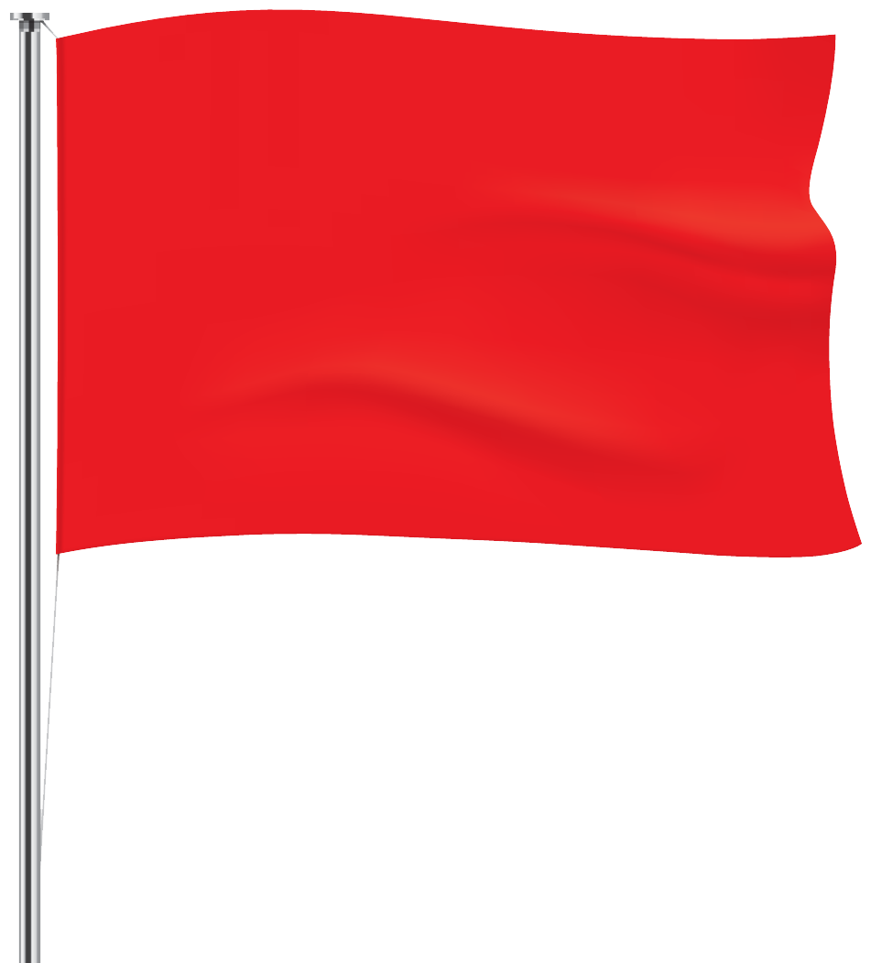
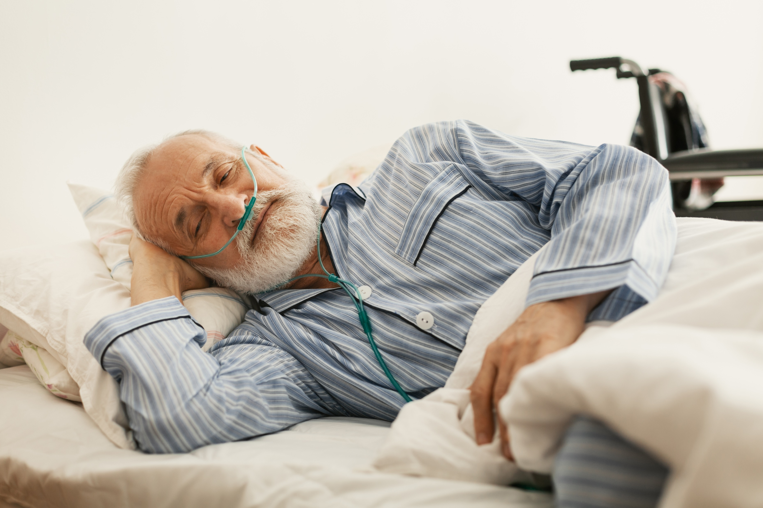
Report Urgently
A person (or someone in their household) smoking when they are on oxygen
Any smoking in bed (this is EXTRA critical with an airflow mattress)
Someone mentioning near-misses with dropped cigarettes
You see new burn marks on someone’s clothes or furniture

Slide 35

During an inspection
Care staff may be asked specifically about their knowledge of safe emollient use, but if not there’s an opportunity for you to mention knowledge in this area when asked a less specific question like, “Tell me some of the ways you keep people safe.”

Slide 36
Part Two

Slide 37
Assessment and Planning
It’s vital to get this right and continue to monitor the situation
You can support people with positive risk taking, but risks must be thoroughly assessed and mitigated so far as is practicable
You must keep relevant people informed at every stage
You may find yourself in conflict with people or their families, but you can also really make a difference to people’s wellbeing
The Fire Brigade are always happy to help
Be reassured that most situations will be straightforward!

Slide 38

All emollient use needs to be assessed and recorded appropriately.
This means for emollient users at low risk, e.g. non-smokers with no realistic sources of ignition, a tick-box approach and standard phrasing to describe the general risk is usually fine.
You would just need to record the names of the product(s) the person uses and how staff are to apply them.

Slide 39
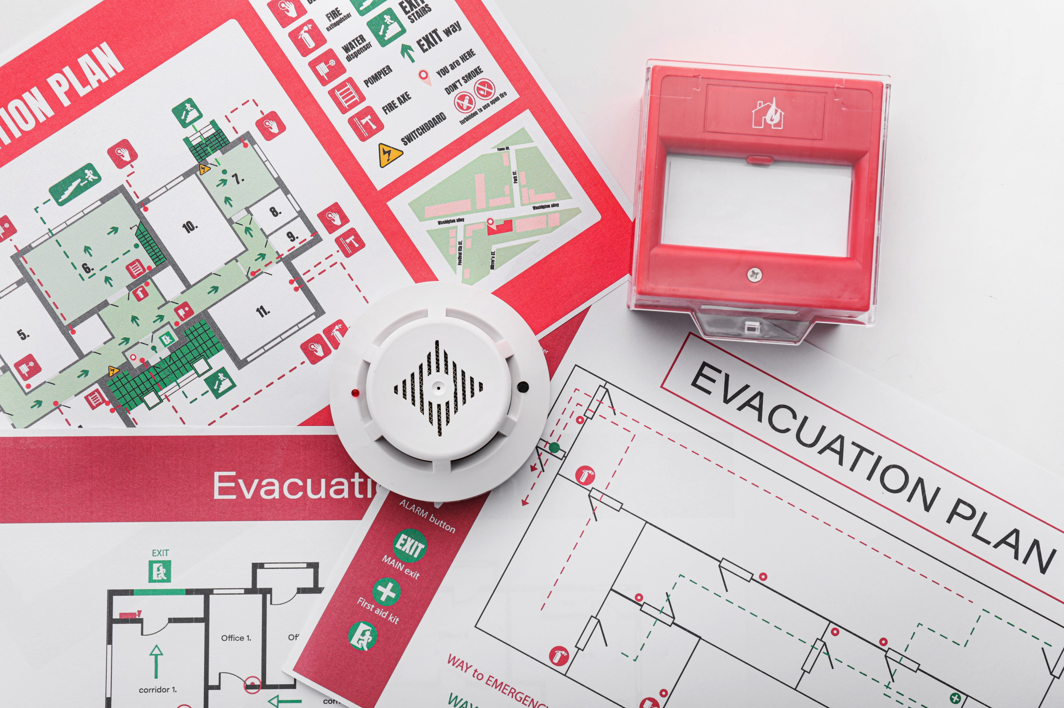
When a risk is present
If a person uses emollients but there is an unavoidable potential source of ignition, you must ensure that your assessment and plans are highly detailed and personalised.
You must ensure that any solutions are in turn properly assessed and documented.

Slide 40
There must be clearly defined and described safe ways of working
These must reduce the risks as far as is practicable to both client and staff
There must be practical and clearly described action to take in an emergency
Documents need to be easily accessible to care staff when they need to refer to them
The agreed emergency action must be in line with your service’s policies and procedures.
People are allowed to put themselves in mortal danger – care staff are not!
Don’t forget to risk assess any emergency action and ensure you have what you need. For instance, if it is agreed that staff will extinguish a personal fire, there needs to be suitable equipment in place such as a fire blanket.
Although fire extinguishers can be used on a person, each type has its own risks when used that way and they need to be considered too.

Slide 41
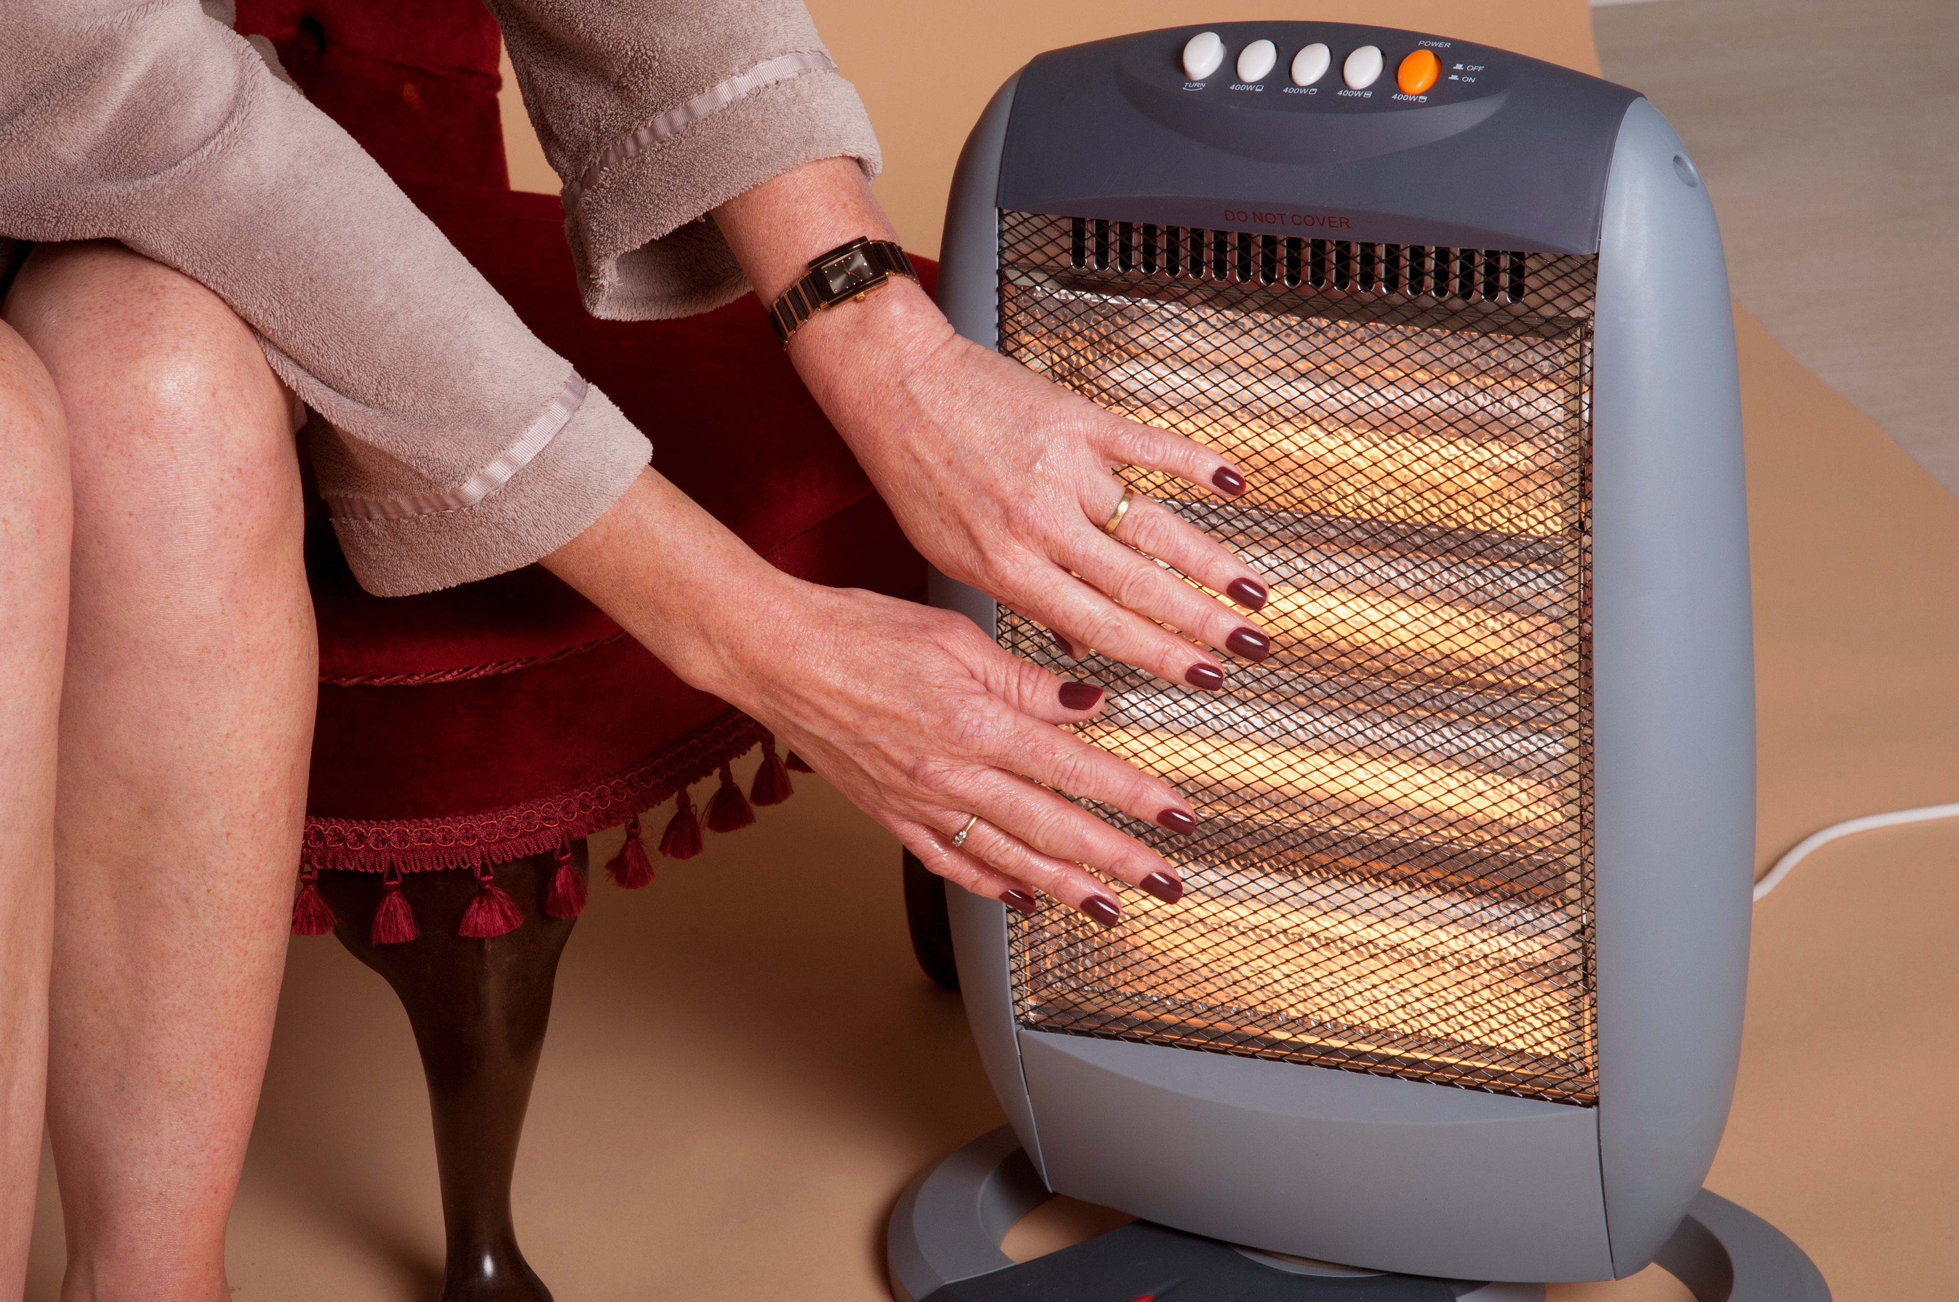
Space Heaters
Space heaters are any kind of individual heater, as opposed to central heating.
As well as assessing the space around them for flammable items and furnishings, and checking they are basically safe and maintained, consider how it will be used.
People often sit very close to them and those with loss of sensation or who are prone to feeling cold are especially vulnerable.

Slide 42
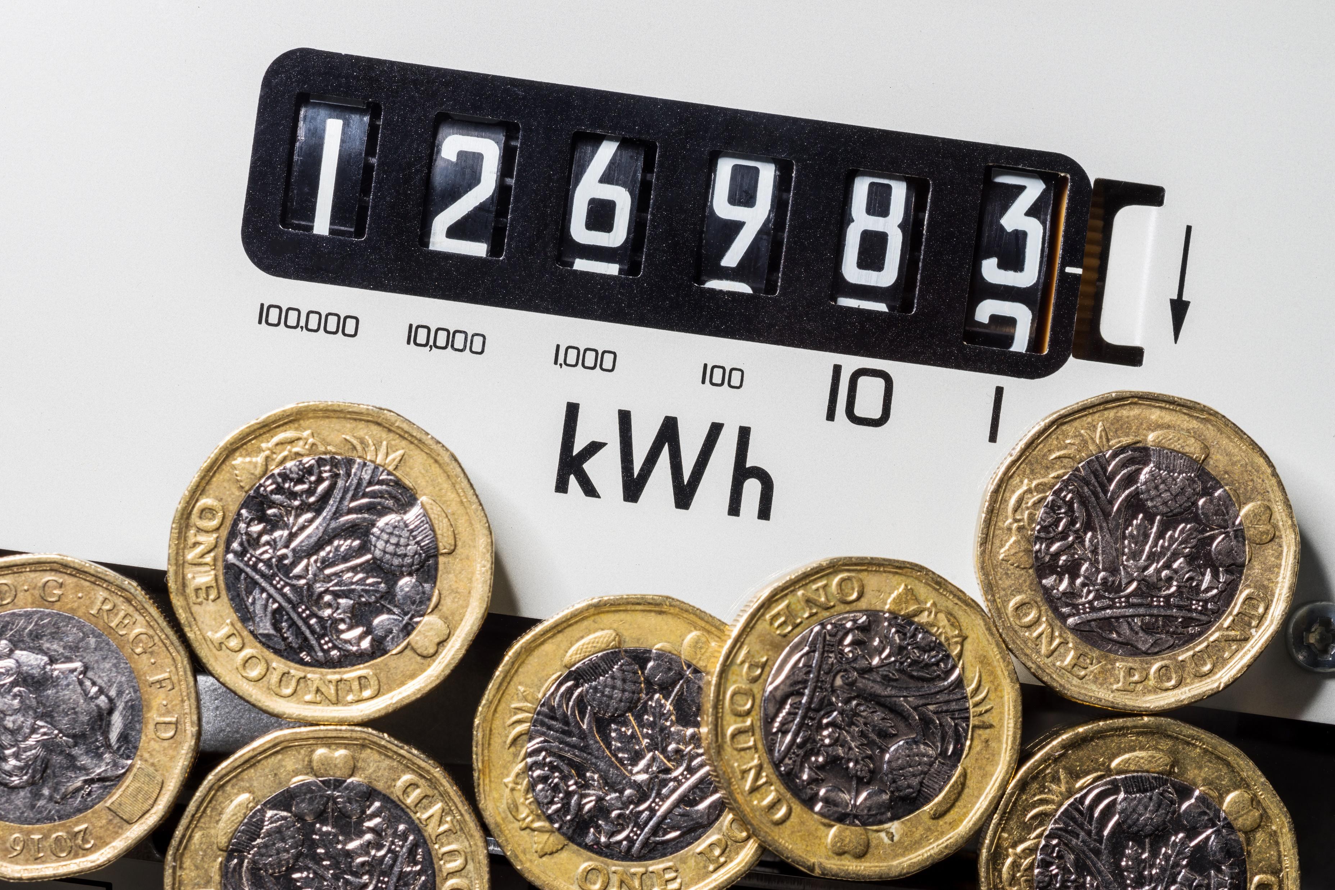
Safe use of space heaters
Space heaters may be someone’s only source of heat, either due to the limitations of their home, or not wanting to use the central heating for whatever reason.
If an emollient user you are assessing appears to be using space heaters when they could be using central heating, you should escalate this.

Slide 43
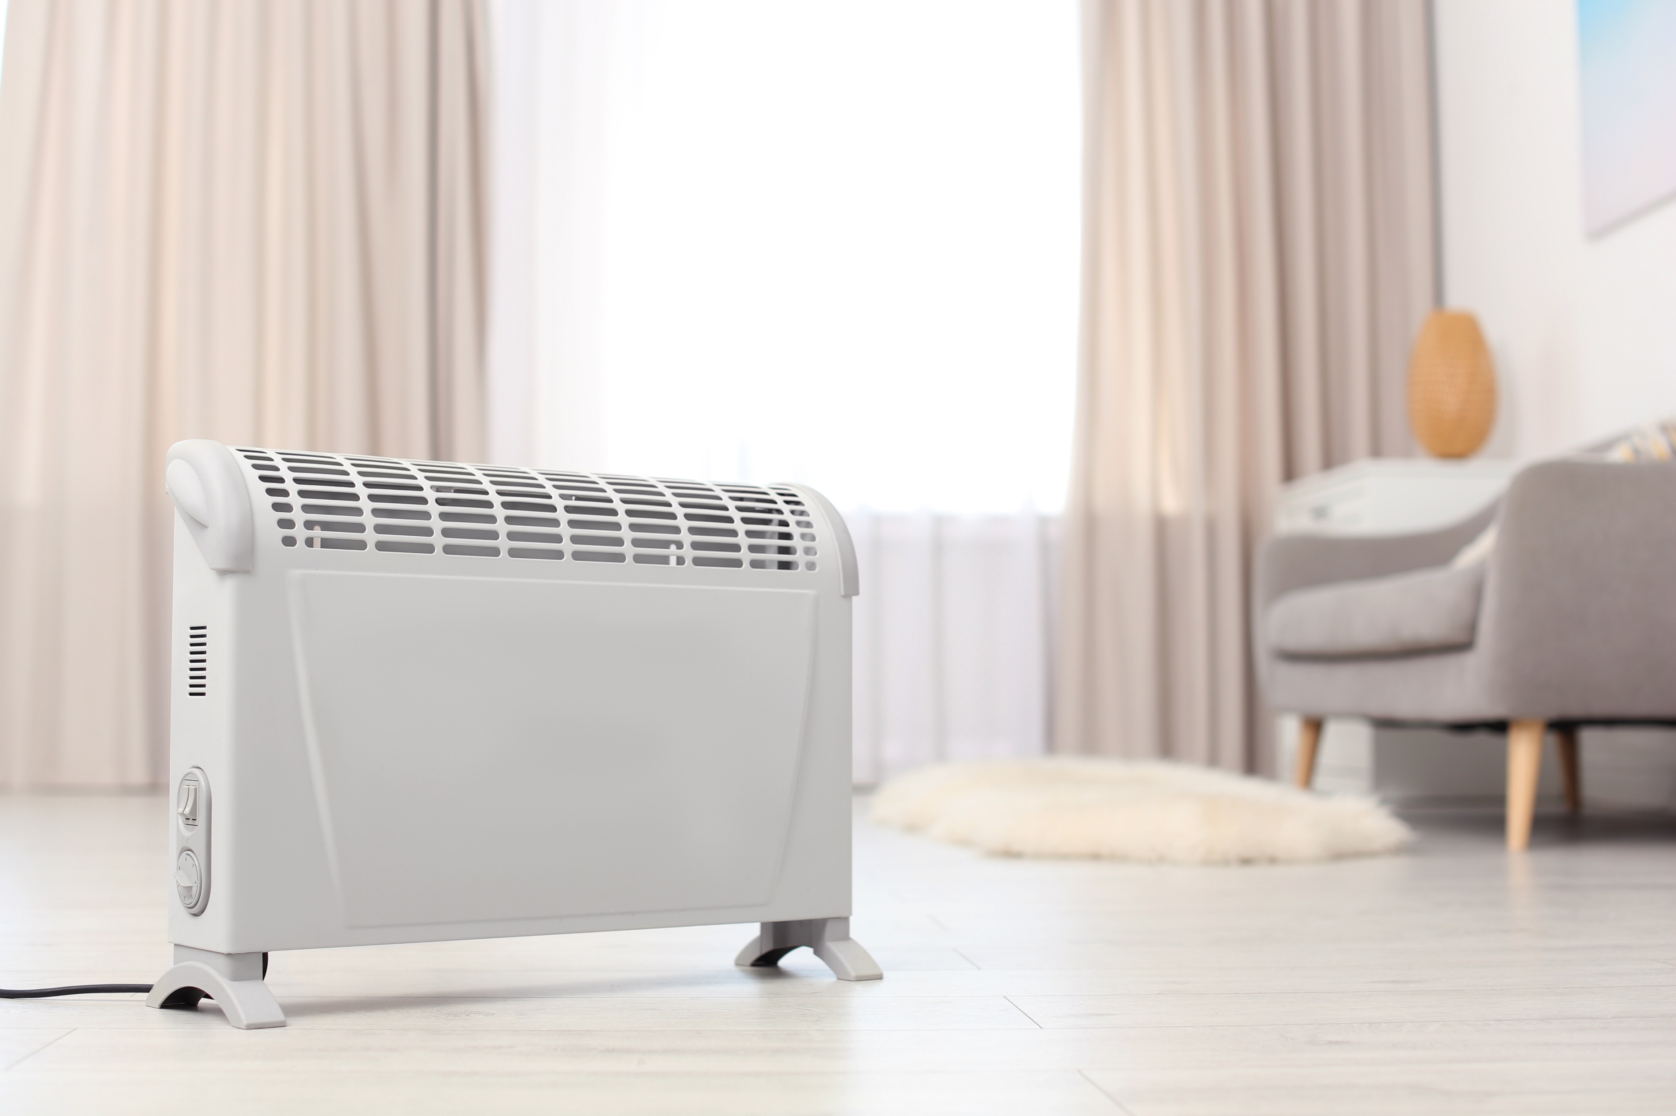
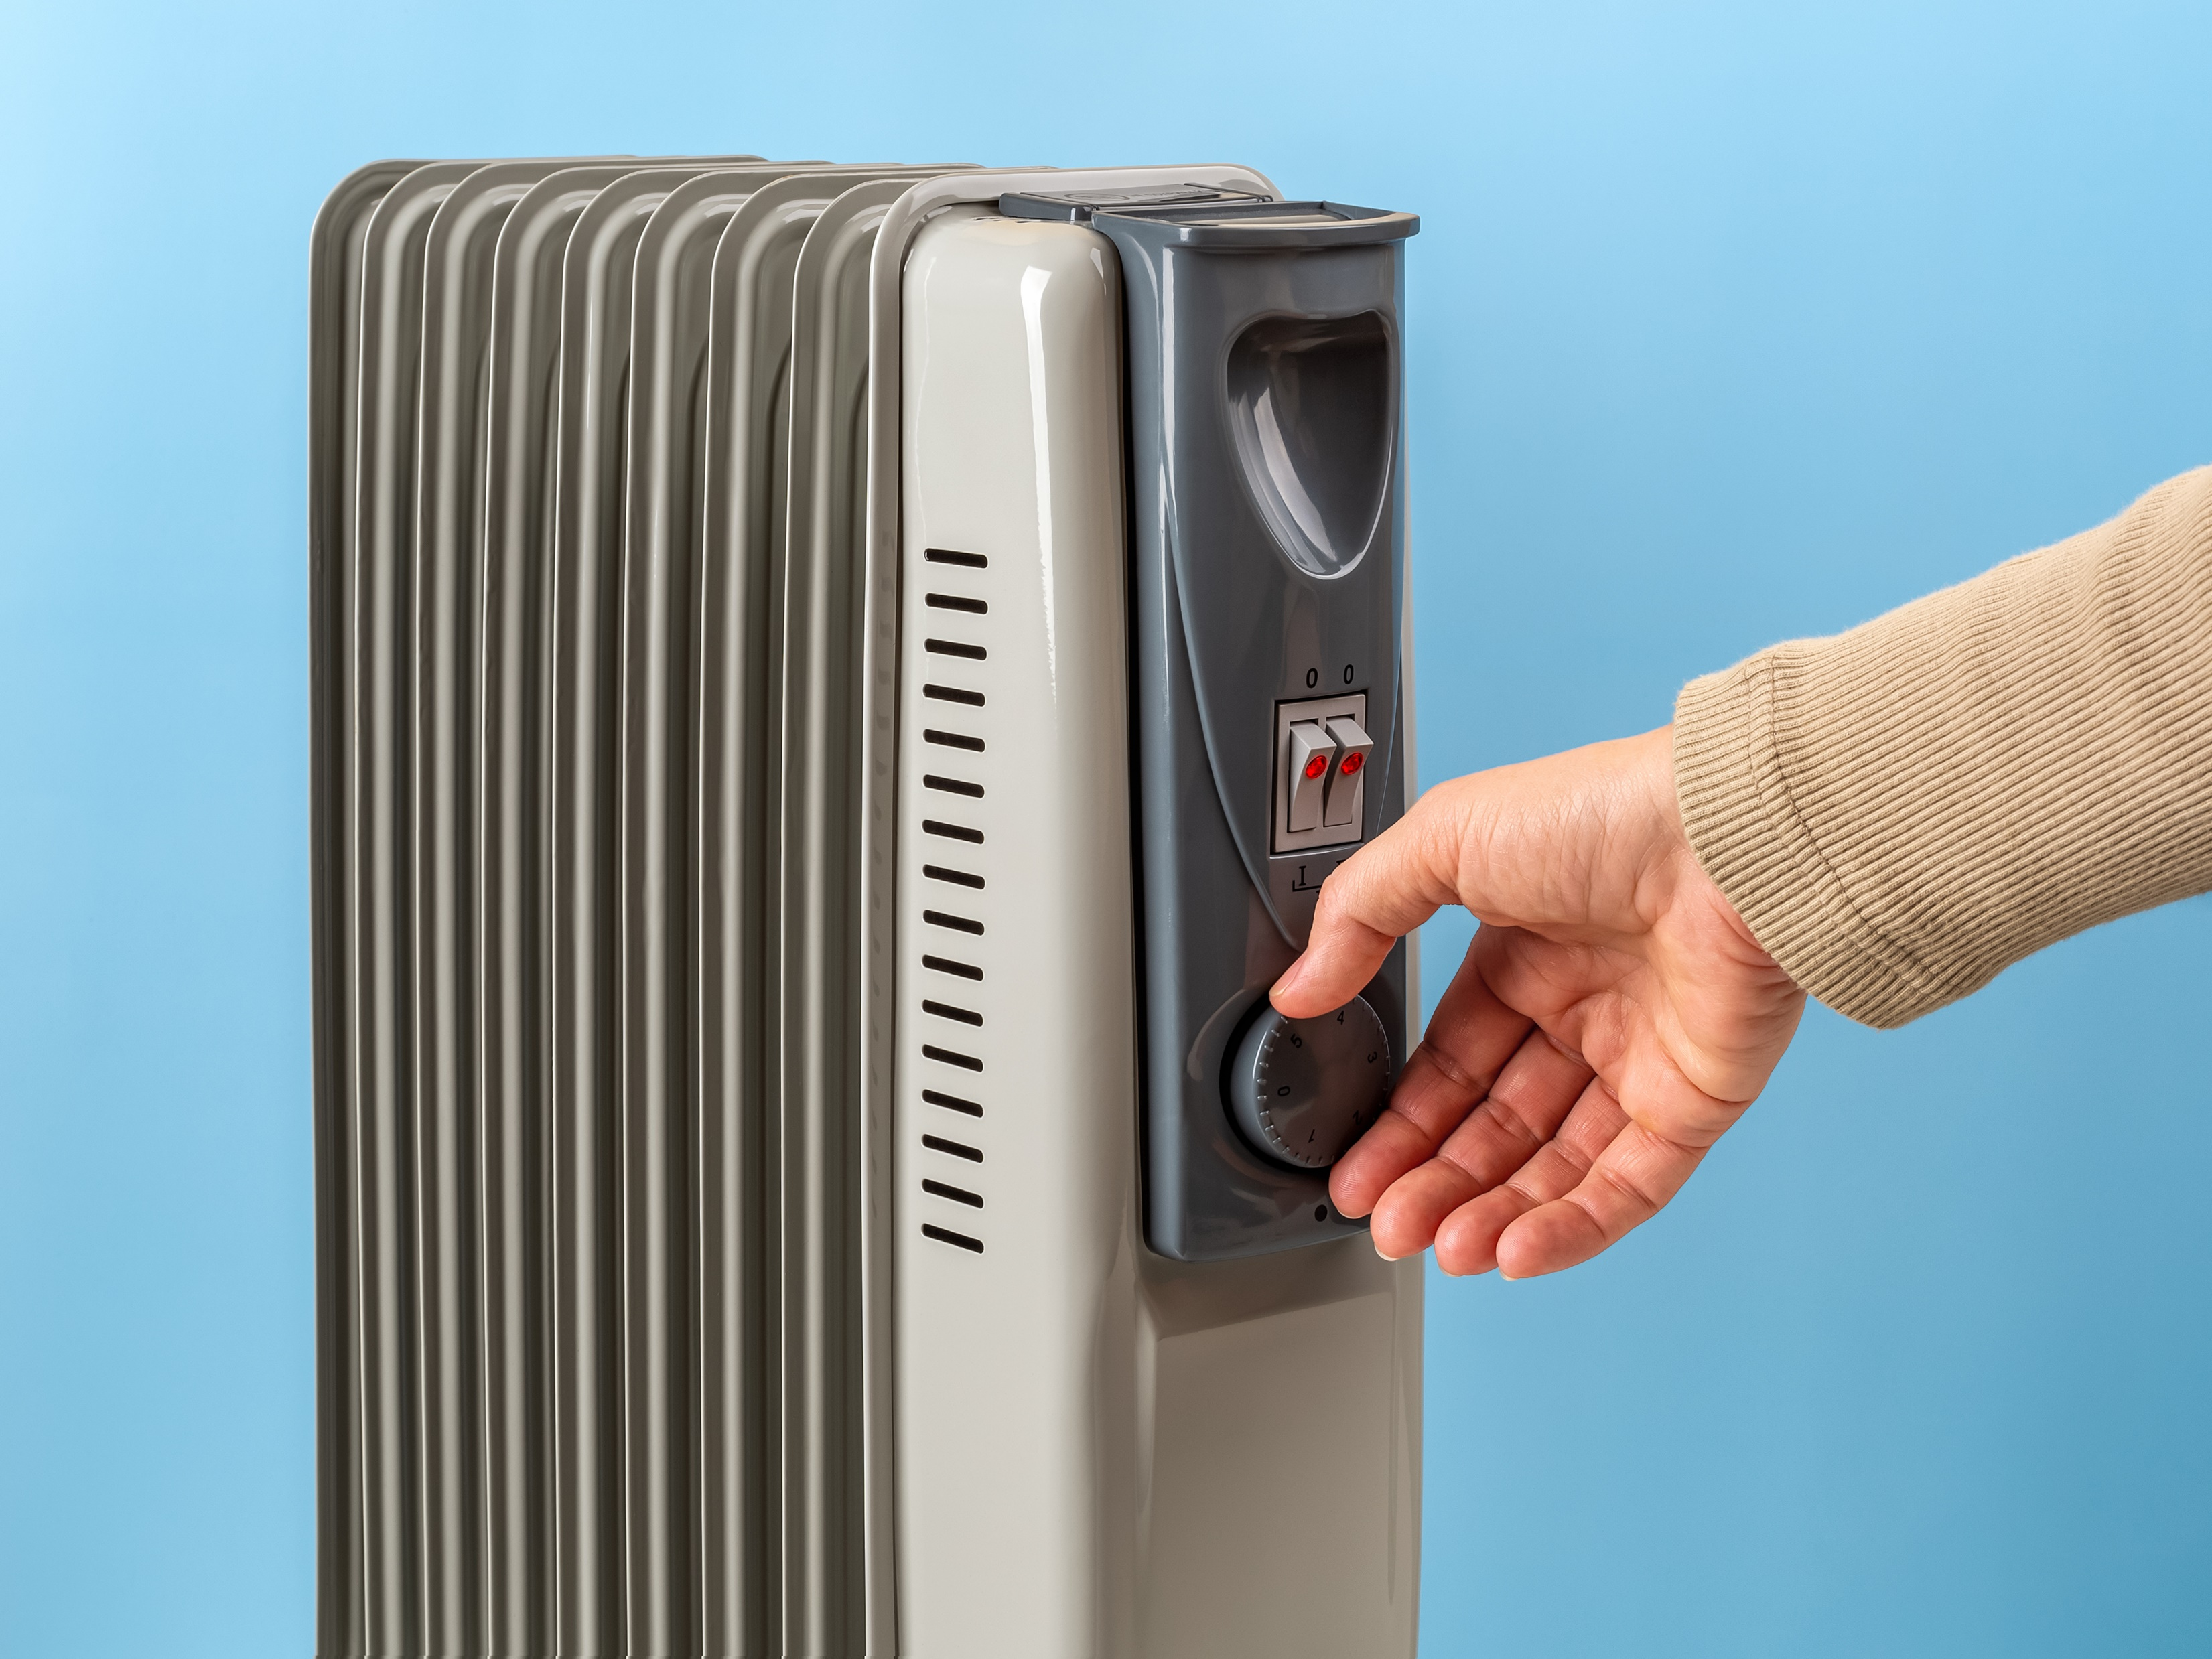
When assessing a space heater, ask yourself questions like:
What happens if it tips over?
What happens if someone falls over it or falls on to it?
Who turns it off at night?
When in use could a flammable item a person might reasonably want with them, like a newspaper, fall on the elements?
Can the person’s pets (and well-meaning friends and relatives!) be trusted around it?
Can you think of any others?

Slide 44
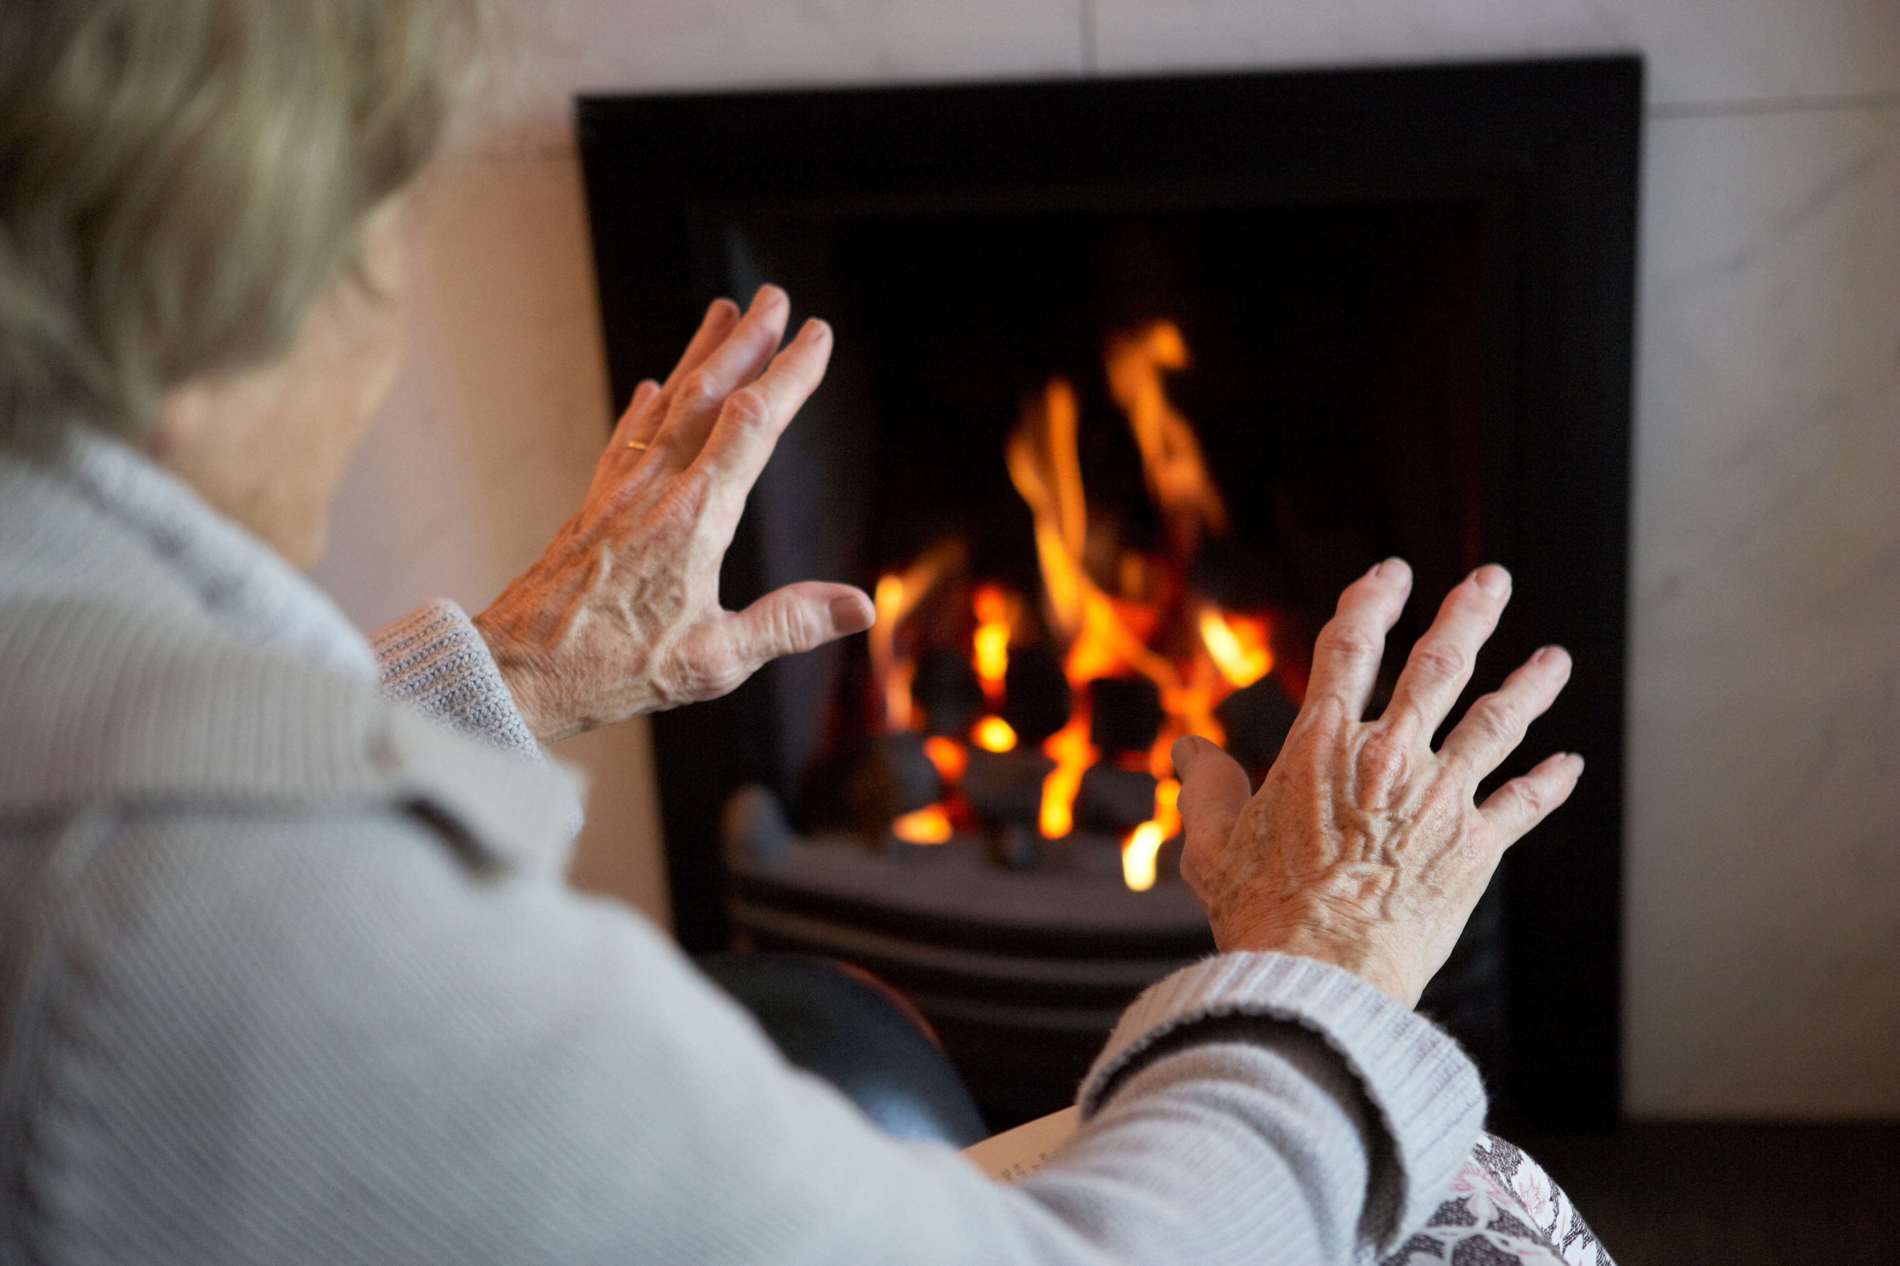
Open / glass fronted fires
These are a potential concern in old or rural properties. Even with fireguards and such routine precautions, they present such an obvious risk that few would insist on using them if there is an alternative.

Slide 45
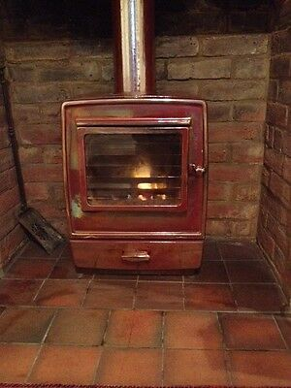
Fires can be vital not just for the room’s heat but also because they heat a “back boiler” in the chimney, which could be the only source of hot water for the house.
If you are required to help people look after a truly essential fireplace, then you must ensure there is a thorough risk assessment and staff have had their tasks properly shown to them and demonstrated competence.

Slide 46
Candles and incense
People may have religious or cultural reasons for burning candles or using incense, and you should enable this as much as is safely practicable.
If staff are unable to safely support with this and there are no family members available, you could appropriately reach out to the person’s community for suggestions, such as through a voluntary organisation.
If someone is burning candles or incense just for aesthetic or air freshening reasons, you should explore acceptable alternatives that do not present the risk of ignition.

Slide 47
Safer Smoking
The safest possible smokers’ materials should be used.
Matches should be absolutely avoided. Lighters in many designs are available.
There are ashtrays designed to address many potential issues, such as the risk of being tipped over or incomplete snuffing out of the finished cigarette.
You will need to empathise and think practically.
For example, a person with steady hands but poor vision might just need a very large and brightly coloured ashtray to prevent most mishaps.
People may only need support with routine tasks like ashtray emptying, or safely lighting up once outside.

Slide 48
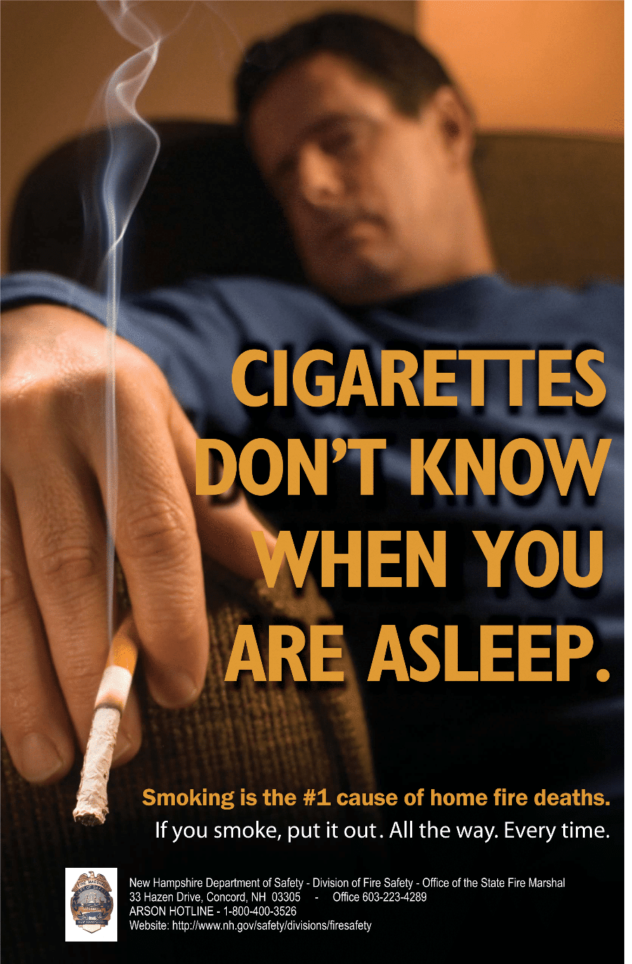
Smoking in bed
Smoking in bed has been a well-advertised safety concern for decades now, and most smokers are used to not casually doing it.
You may however have to negotiate over this with people accustomed to smoking in their home who have become confined to bed and wish to continue. People’s choices are important, even if risky.

Slide 49
Whilst you should probably never agree to support someone with smoking whilst on oxygen or an airflow mattress, or any other ridiculously dangerous situation, there may be other times where we do things that seem risky. For example:
Someone might want to be transferred from bed to a wheelchair and taken to the smoking area, even when that transfer is complex or painful for them.
Someone receiving oxygen therapy may wish to be disconnected and taken outdoors to smoke – if so, they and the escorting staff member should thoroughly brush their clothes down before smoking, as oxygen can cling to clothing.
Where smoking is permissible indoors, you could agree to someone’s bed being placed under an openable window to enable supervised smoking.
Of course you can never force any staff to put themselves in danger, but your staff who smoke are in a position to be particularly supportive and empathetic to people who wish to continue to smoke even if it is risky.

Slide 50
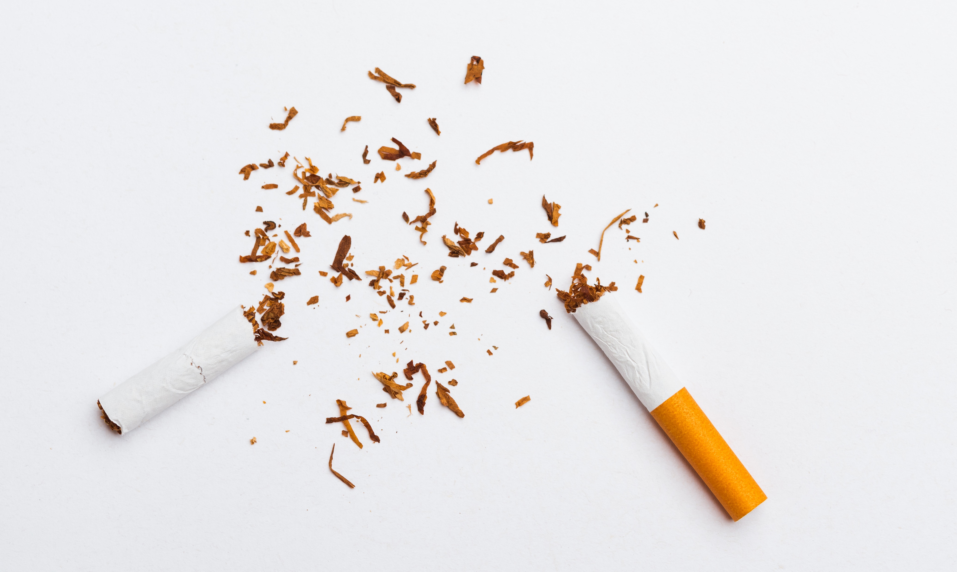
Smoking alternatives and cessation
Never nag people to give up.
If people do want to stop completely, refer them to local cessation services through the appropriate channels.
People may be open to new suggestions such as vaping and other alternative nicotine products, especially if part of a safer smoking plan and as a stopgap to prevent cravings in between scheduled supported smoking time, in bad weather, or when staff availability is restricted.

Slide 51
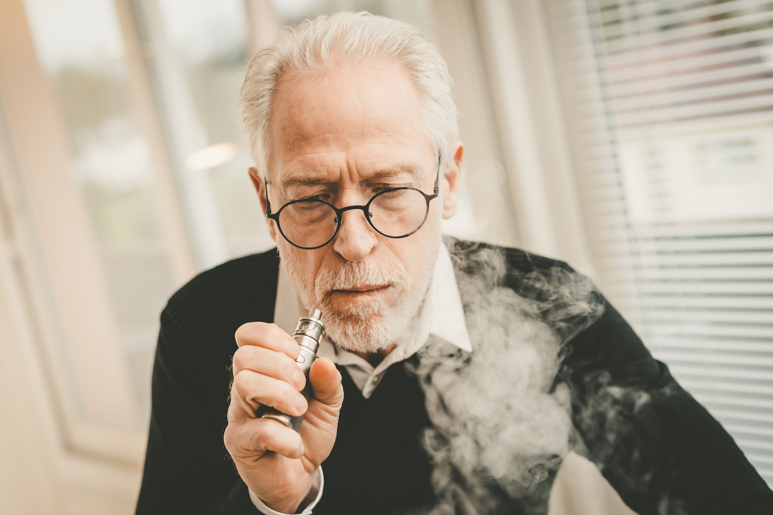


Vaping
The current advice from PHE is that health-wise, vaping is better than smoking.
It does however have its own risks, so ensure you assess any vaping devices and their chargers as you would any other small electronics – cheap or defective ones are a particular hazard.
They also often contain glass and may be difficult for a person with limited dexterity to manage without support.
A CE marking does not indicate that a product has been approved as safe by the EU/another authority.
It means that the manufacturer has checked that the product complies with all relevant essential requirements.

Slide 52
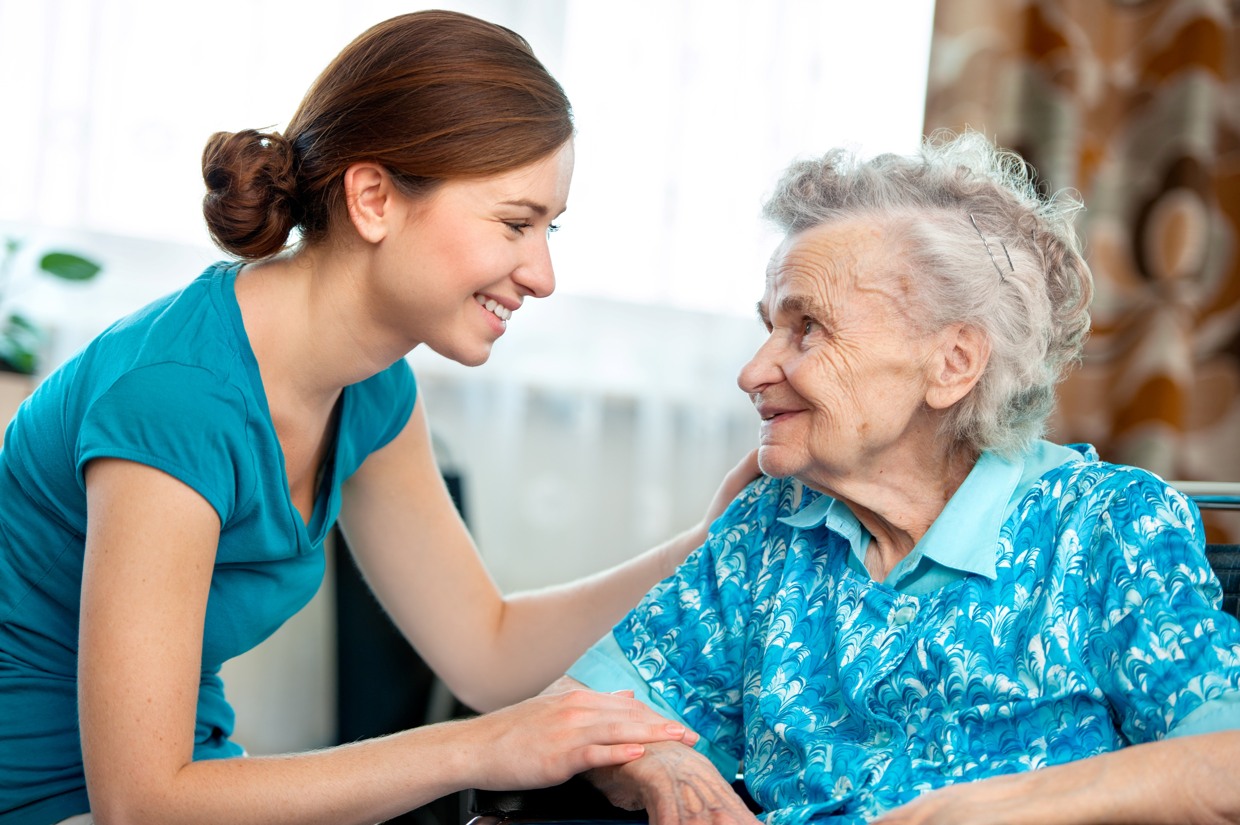


Documentation
People should never be at higher risk just because a new care worker is attending.
Your risk assessments and support plans must pass the “new carer test”, that is: “Could a new care worker safely look after this person based on this?”
We know she’s a newbie – forgetting to wear her gloves when applying cream... ☺

Slide 53
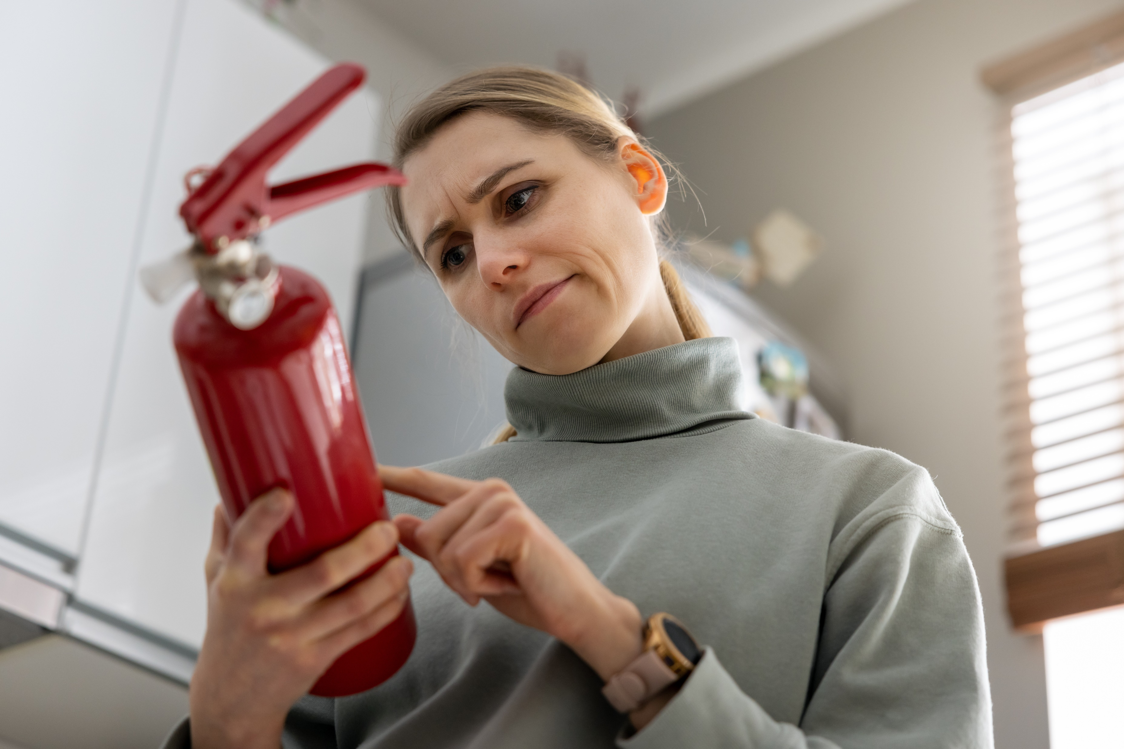
When writing or reviewing a person’s documents, you should make sure you have:
Identified any concerns
Made practical plans to manage them
Recorded these clearly for care staff, in an accessible format
Set a realistic review schedule
Responded to any changes
Make sure plans are suitably detailed: for instance, don’t just tell staff to use a fire extinguisher, tell them where it is kept and how to use it safely in this context. Treat it like any other vital equipment in terms of maintenance and record keeping.

Slide 54
Managing risk to staff
Risks to staff must be clearly defined and freely agreed with those who will be doing the actual care.
You should give consideration to what might happen if staff who have agreed are unavailable - a “Plan B” should be in place.
You must document everything, and ensure you communicate clearly and effectively with everyone involved.
Your general staff risk management principles should apply.

Slide 55

Auditing
Disasters usually happen because seemingly minor threads make a knot.
The auditor’s overview puts you in an excellent position to spot potential knots before they form.

Slide 56
Ensure you are familiar with names of common emollients.
Always cross check care records against risk assessments and support plans when emollient use is mentioned.
Ensure any concerns mentioned in care records have been reported and followed up appropriately.
If ever you aren't sure that staff are correctly supporting with emollients, or have concerns about the assessment or plan, escalate this appropriately and efficiently.
These questions are two sides of the same coin:
Do these documents show that staff are following the care plan, and that the person is being kept safe?
Is the service also protected? Could we adequately account for what we have done here, if asked in the future?

Slide 57
Potential conflicts
You can assess every hazard and make the best plans in the world to minimise the risks but those plans still depend on the consent of the person, and often the assistance of their loved ones, to carry them out.
There are probably going to be times when you have to discuss with people and their relatives what accommodations and changes they are willing to make to ensure that everyone is safe.
This may occasionally put you in conflict with a person or their family members.

Slide 58
Dealing with conflicts
Sometimes clear boundaries have to be drawn, often because of an unacceptable risk.
Whilst people can take their own risks, they have no inherent right to impose risks on anyone else.
For instance, if a person or a family member refuses to follow a reasonable safer smoking plan, then it’s likely you should refuse the service or quit in line with your contract.
This would include anyone smoking indoors when staff are present, unless it’s part of the agreed plan.

Slide 59

Another time you may find yourself having to draw boundaries is when family members disagree with a risk you are supporting a person to take.
If the person has the capacity to make the decision (or you have a well-documented best interests process), you have a robust risk assessment and clearly agreed safe systems of work with your staff, then stand your ground!

Slide 60
You may need to request extra time for a care visit, or more one-on-one time, in order to safely support emollient users who are at risk.
Make sure you have the evidence that this is needed, such as care notes and ECM records, and if necessary be prepared to defend more unusual requests like supervising smoking in bed.
You may find yourself in conflict with your own organisation, for instance if you spot a previously unrecognised hazard like neglected decking in a care home’s smoking area, and feel the corporate response is lacking.
Evidence is always key: ensure you keep records of any relevant communication and don’t be afraid to escalate your concerns, externally if need be.

Slide 61

Keeping up to date
Responsibility for keeping up to date with patient safety alerts, and other best practice guidance, should be allocated and the duties clearly defined.
There need to be effective ways to share new information with all staff.

Slide 62

Inspection Guidance
If this is an area in which your service has previously been deficient, then how you identified this and responded to that realisation could be evidence for a strong culture of learning and improvement.
It’s a great chance to prove that your service is well managed– for instance, following training, it’s very likely that staff will spot hazards they didn’t recognise previously, so if you can readily ensure that your assessors have the availability to follow up any concerns in the days and weeks following training then that speaks to the management and resourcing of the service.

Slide 63
Good documentation can give you impressive evidence to use during inspection that goes beyond merely meeting safety regulations, for example:
Inspections are a good chance to show off your quick reporting and response to changes, as a staff member’s eye for detail could identify a new hazard and genuinely save a life by preventing a personal or domestic fire.
How you have worked out a way of working that keeps the person as safe as possible as well as protecting your staff could demonstrate your broader ethos and attitude towards risk assessment.
Positive risk-taking shows you care about people’s independence and dignity and understand that the people you care for make their own decisions, even when they aren’t optimal safety-wise.
How you initially respond to someone’s decision to continue any risky behaviour could demonstrate your understanding of mental capacity issues and best interests decisions.
How your team responds to well-meaning family members who are not respecting their relative’s wishes or who are subverting your safety plans could also show your skill and diplomacy.
Can you think of any other evidence it could give you?

Slide 64
The Regulations
Health and Social Care Act 2008 (Regulated Activities) Regulations 2014
Regulation 12: Safe care and treatment, particularly those sections relating to risk assessments (a), doing all that is practicable to mitigate risks (b), staff training and competence (c), equipment (e), safe management of medicines (f, g), and for care homes, the safety of premises (d).
Leadership failings in this area would likely fall under Regulation 17: Good governance, particularly (2)(b), managing risk.
This really is a critical area, so if your inspector does find deficiencies then it is most likely that you will be found to be in breach the regulations.

Slide 65
Case Studies
Here are some case studies of emollient users in interesting situations for your consideration as a group.
If the service type isn’t your own, you’ll still find considering the situation useful as the same or similar principles still apply.

Slide 66
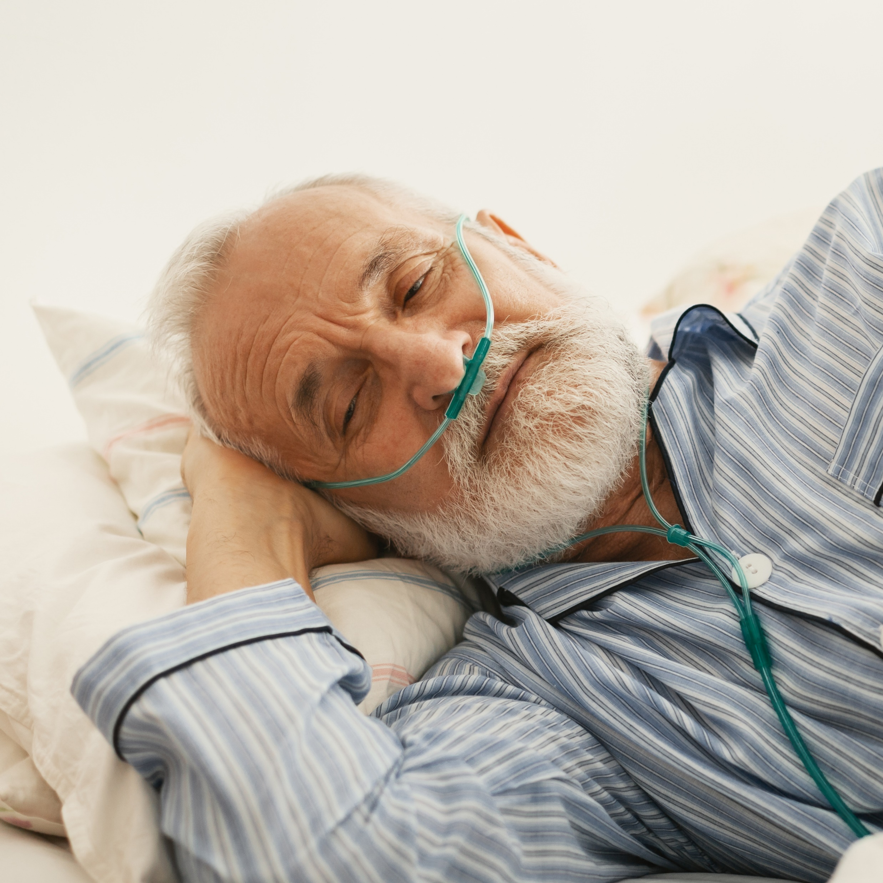
Jim is 75, and you have been privately providing home care to him every morning for two years, after he had his lower left leg amputated following diabetes complications.
He has emphysema, and his other leg is now rather ulcerated. He spends much of his day in bed or recliner, rather low in mood, watching TV. He continued to smoke and his wife had helped him manage this safely.
However, he has recently been prescribed oxygen therapy. His wife is now refusing to allow him to smoke, and has taken away all his cigarettes. Jim has become increasingly depressed. His wife asks if you can help.

Slide 67
Jim is 75, and you have been privately providing home care to him every morning for two years, after he had his lower left leg amputated following diabetes complications.
He has emphysema, and his other leg is now rather ulcerated. He spends much of his day in bed or recliner, rather low in mood, watching TV. He continued to smoke and his wife had helped him manage this safely.
However, he has recently been prescribed oxygen therapy. His wife is now refusing to allow him to smoke, and has taken away all his cigarettes. Jim has become increasingly depressed. His wife asks if you can help.
Key points for Jim:
Ensure any medical support, such as from the GP, is sought appropriately for his low mood.
Jim seems like a good candidate, if practicable, for positive risk taking and a safer smoking plan, with the rationale that his mental health is deteriorating and this could well promote his general well-being.
As Jim is on oxygen, he will need to be safely transferred to a chair and outside – could be painful but there doesn’t seem to be a physical reason why not. Accessibility and shelter arrangements may need to be made.
Detailed safety arrangements will need to be in place, probably including practical training for new staff.
Paying for extra time and improvements may or may not be an issue.

Slide 68

Geoff is 93, has dementia, and has been living in your care home for a year, during which time his condition has worsened, and he now doesn’t speak much.
Recently he has frequently started trying to follow staff and visitors out through the locked door of his wing, but also getting increasingly agitated when then guided outside to the garden in response. One day he “vanishes”, and is found soon after in the smoking shelter, puffing away happily with a visitor who says Geoff approached and asked her for a cigarette. She is surprised and embarrassed when she realises he is a resident.
You immediately speak to his son who is absolutely horrified. “He only gave up a few years ago! Don’t let him start again!”

Slide 69
Geoff is 93, has dementia, and has been living in your care home for a year, during which time his condition has worsened, and he now doesn’t speak much.
Recently he has frequently started trying to follow staff and visitors out through the locked door of his wing, but also getting increasingly agitated when then guided outside to the garden in response. One day he “vanishes”, and is found soon after in the smoking shelter, puffing away happily with a visitor who says Geoff approached and asked her for a cigarette. She is surprised and embarrassed when she realises he is a resident.
You immediately speak to his son who is absolutely horrified. “He only gave up a few years ago! Don’t let him start again!”
Key points for Geoff:
He’s not long given up smoking, and may well have simply regained the desire to smoke. It’s clearly important to him, as he spoke about it and was calm and happy with the visitor.
Geoff doesn’t seem to have an especially high personal fire risk from the smoking other than his emollient use – he is mobile and with no physical impairment.
There is a clear rationale for a safer smoking plan, but also a clear need for a well-documented best interests decision.
Your paperwork would need to be absolutely watertight.
What would the impact be if the next of kin had power of attorney for health and welfare?

Slide 70

Rivka is 86 and is planning to move into your care home from hospital, where she has been in rehab since she had a stroke several months ago. She is still unable to use her right arm or hand for trickier things, and has some weakness on that side (she is usually right-handed).
She is safely mobile with suitable equipment and has otherwise recovered well. When you meet her to assess her needs, she tells you that she is Jewish and prior to her stroke, she used to light Shabbat candles just before sunset every Friday. She’d like to resume doing this, and asks how you can help her to do it safely.

Slide 71
Rivka is 86 and is planning to move into your care home from hospital, where she has been in rehab since she had a stroke several months ago. She is still unable to use her right arm or hand for trickier things, and has some weakness on that side (she is usually right-handed).
She is safely mobile with suitable equipment and has otherwise recovered well. When you meet her to assess her needs, she tells you that she is Jewish and prior to her stroke, she used to light Shabbat candles just before sunset every Friday. She’d like to resume doing this, and asks how you can help her to do it safely.
Key points for Rivka:
This is relatively easy to facilitate in a residential context.
Straightforward precautions such as good lighter selection, staff supervision, and the candles being lit in an area where they won’t be left unattended are required.
Find out what the ritual requirements are and how they impact your plans in practice – e.g. timing of the candle-lighting will vary from week to week and they shouldn’t be blown out, so you’d need to avoid candles with a long burning time in summer.
Consideration may need to be given to the home’s fire detection systems reacting to the candles.
Why would this be rather more interesting situation in domiciliary care? What plans might you make then?

Slide 72
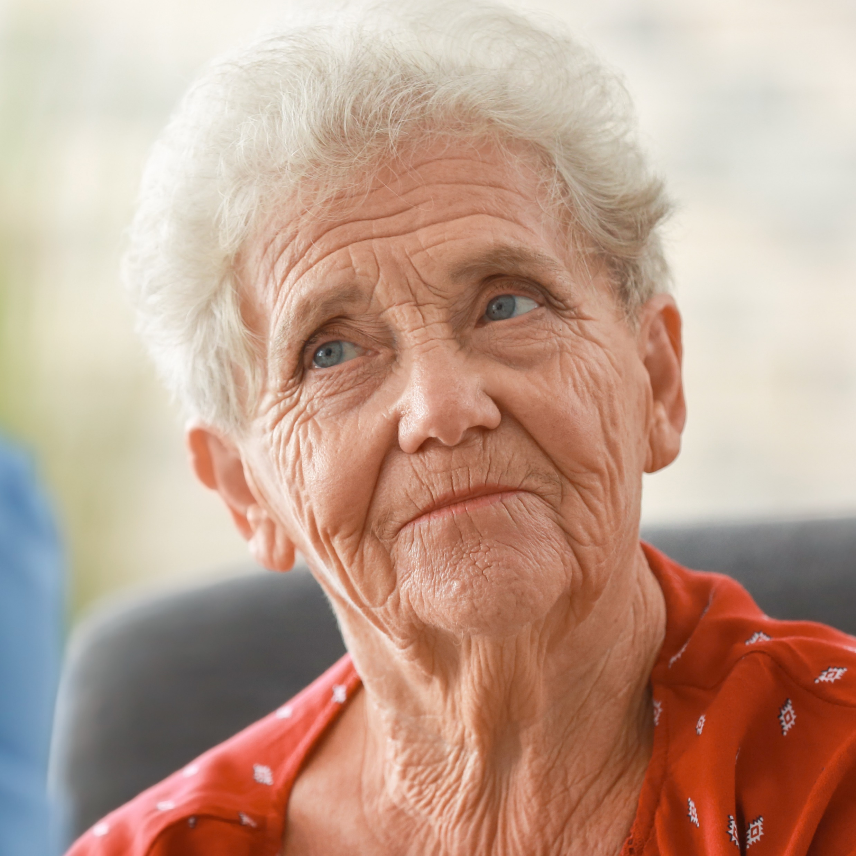
Moira is 95, has dementia, and has been referred to you by social services for home care. Her previous agency gave notice as her confusion and forgetful chain-smoking had caused several near-misses, and she was adamant she wanted to smoke. Indeed, you see evidence of many old burn marks on her furniture and clothing. Moira is dismissive of these.
Her daughter, who has been supporting in the interim, confidently reassures you that she has now resolved this issue by applying nicotine patches to Moira’s back, telling her that they are for pain relief. As a result, Moira now very rarely smokes, as she doesn’t get cravings. Her smokers’ materials and cigarettes are still there should she want them, so she doesn’t try to go out and buy them.
The family ask you to carry on applying the patches as part of Moira’s personal care routine when you take over.

Slide 73
Moira is 95, has dementia, and has been referred to you by social services for home care. Her previous agency gave notice as her confusion and forgetful chain-smoking had caused several near-misses, and she was adamant she wanted to smoke. Indeed, you see evidence of many old burn marks on her furniture and clothing. Moira is dismissive of these.
Her daughter, who has been supporting in the interim, confidently reassures you that she has now resolved this issue by applying nicotine patches to Moira’s back, telling her that they are for pain relief. As a result, Moira now very rarely smokes, as she doesn’t get cravings. Her smokers’ materials and cigarettes are still there should she want them, so she doesn’t try to go out and buy them.
The family ask you to carry on applying the patches as part of Moira’s personal care routine when you take over.
Key points for Moira:
A safer smoking plan is unlikely to succeed, as there is a history of near-miss incidents and Moira would be unlikely to comply with restrictions to her smoking.
The daughter’s plan is rather a cunning one, but you’ll need to ensure your best interests decision paperwork is watertight and you have appropriately notified everyone who should be.
Care workers should avoid directly lying to Moira or evading her about the reason for the patch, should she ask, as recognising dishonesty could impact her trust of them.
As she is still occasionally smoking, you’ll need to ensure there is a good risk assessment and emergency plan in place.

Slide 74
Questions and discussion

